Slide 1
Using Integration Services to Load Two Fact Tables in the MaxMinManufacturingDM Database
This Tutorial is based on the Learn By Doing Exercise in Chapter 8 of Brian Larson’s Book: Delivering Business Intelligence with Microsoft SQL Server 2012, 3rd edition.

Slide 2
The Purpose of this Tutorial
To extract some fact data from a source text file (BatchInfo.CSV) and from a database (OrderProcessingSystem), which is an OLTP database based on a relational data model. The BatchInfo.CSV and OrderProcessingSystem database should be located in the same folder where you stored the MaxMinAccounting database that you downloaded for the second tutorial (see Tutorial 2, Slide #3). If you used the default option, that folder name is …\0071759387_code. You need to restore the OrderProcessingSystem database using SQL Server Management Studio as follows: Find OrderProcessingSystem Database Install subfolder and open it. You should see a file that explain how to install the OrderProcessingSystem database as well as a backup file. Open the instructions file and follow the steps to restore the OrderProcessingSystem database backup.
If necessary, to do some transformation by aggregating these extracted fact data.
To load the extracted fact data to the ManufacturingFact and InventoryFact tables in the destination database (MaxMinManufacturingDM). This database is a multidimensional database that you have created early in the first tutorial.

Slide 3
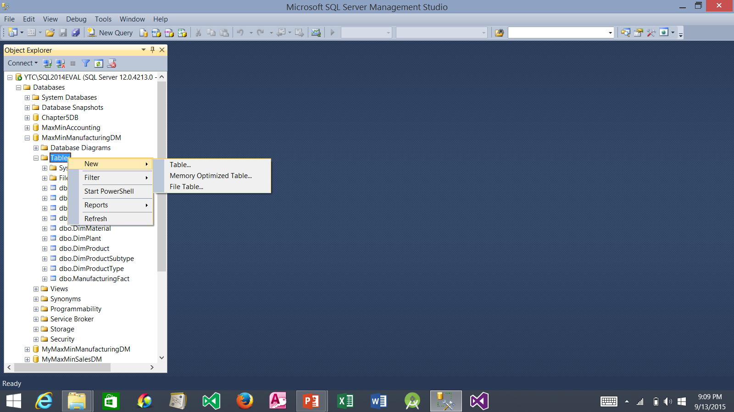
Adding a Second Fact Table to the MaxMinManufacturingDM Data Mart
1. Launch SQL Server Management Studio
2. You should see the MaxMinManufacturing data mart that you created in Tutorial 1.
3. Right-click the Tables node, select New, and then select Table…

Slide 4
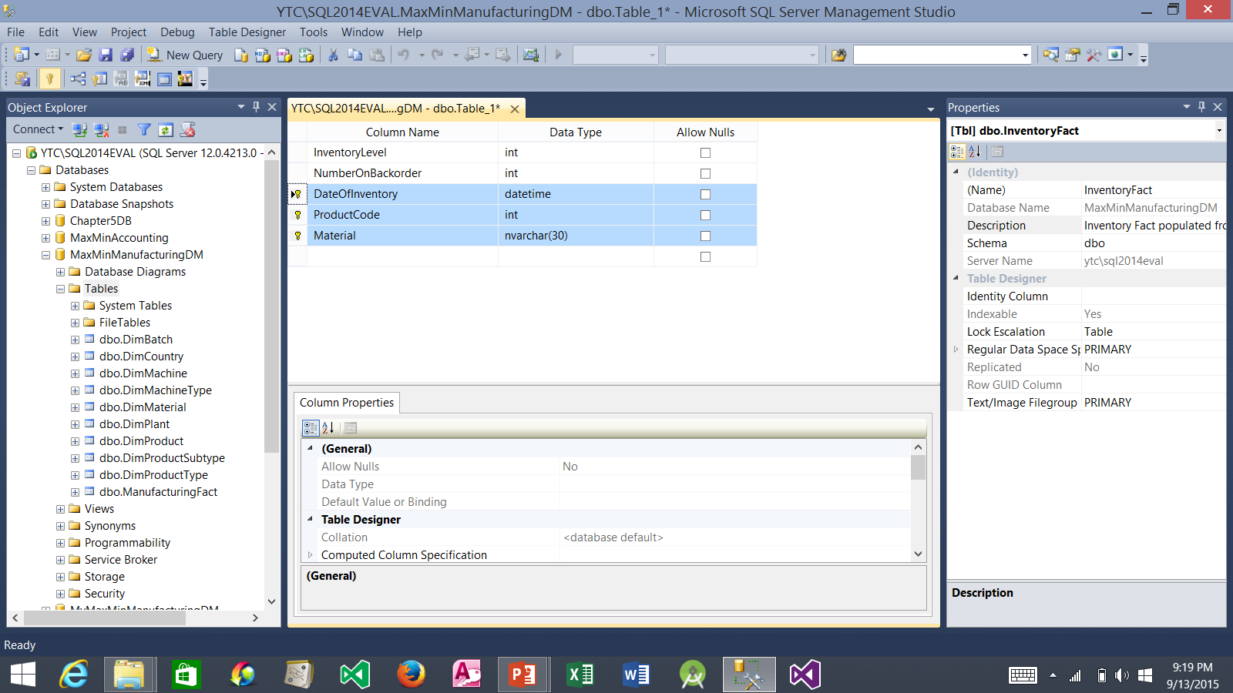
Adding a Second Fact Table to the MaxMinManufacturingDM Data Mart (continued)
5. Click x to close the new table.
1. In the Name field, type InventoryFact
4. Click the Save button
3. Add the following columns and set DateOfInventory, ProductCode, and Material as the primary key.
2. In the Description field, type Inventory Fact populated from the Order Processing System database.

Slide 5
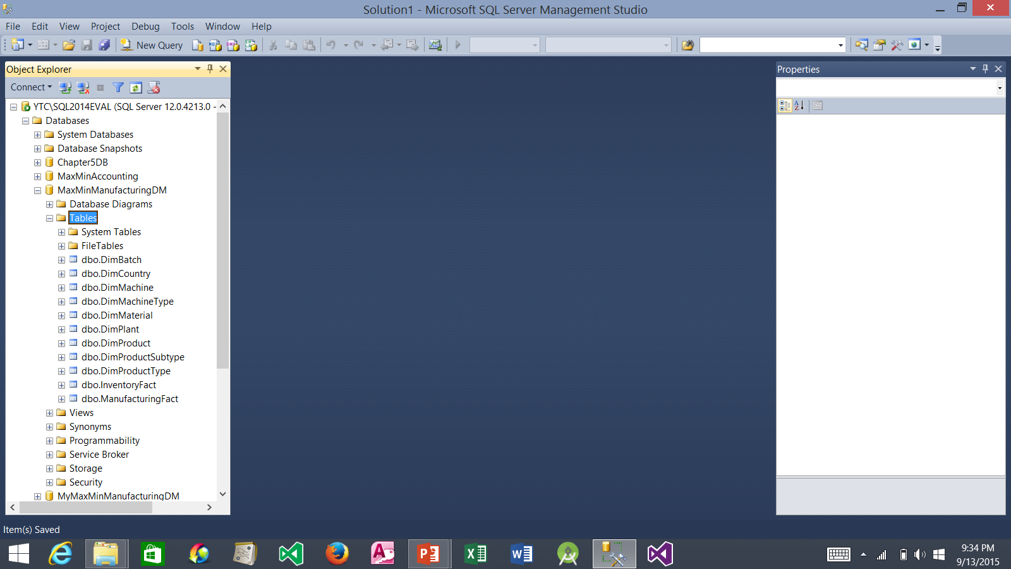
Adding a Second Fact Table to the MaxMinManufacturingDM Data Mart (continued)
3. Click this red x to close the SQL Server Management Studio. Next, we will use the Integration Services to populate both the InventoryFact and ManufacturingFact tables.
1. Right-click the Tables node and select Refresh.
2. The newly created InventoryFact table should be visible.

Slide 6
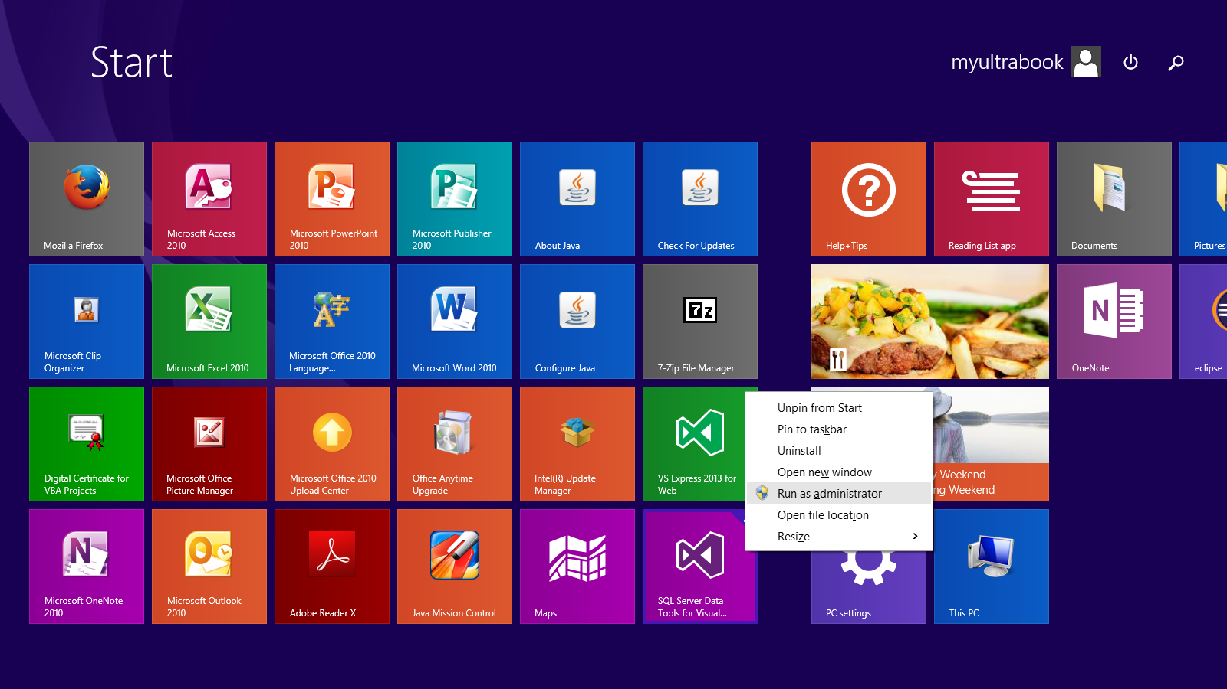
Launch SQL Server Data Tools
1. Right-click the SQL Server Data Tools icon.
2. Select Run as administrator

Slide 7
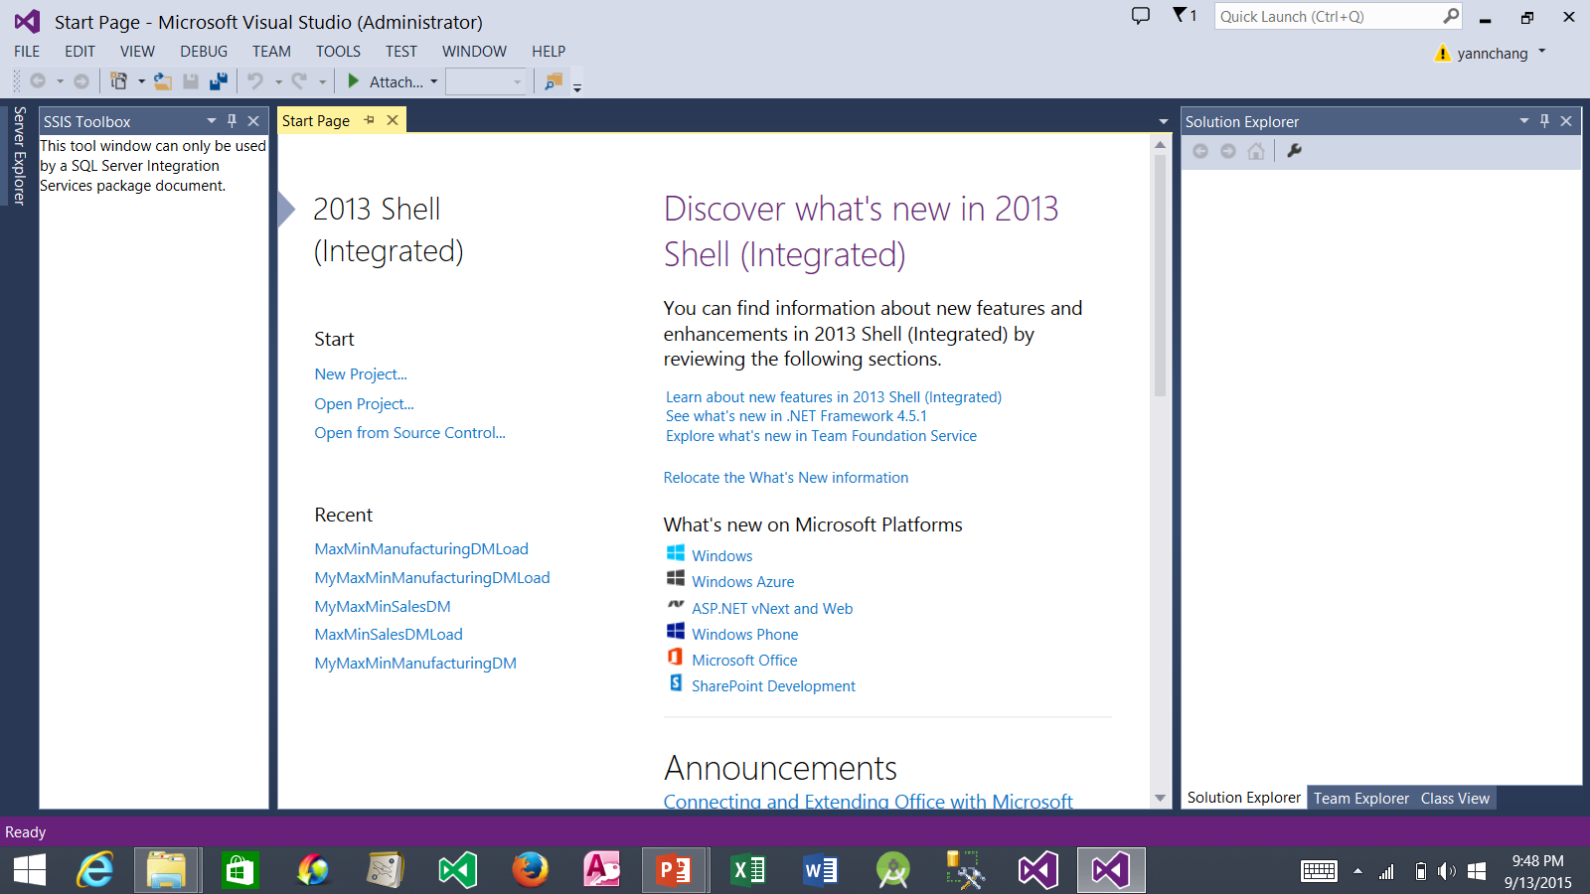
Open MaxMinManufacturingDMLoad Project
1. Click MaxMinManufacturingDMLoad project to open it. Note: you created this project in Tutorial 2.

Slide 8
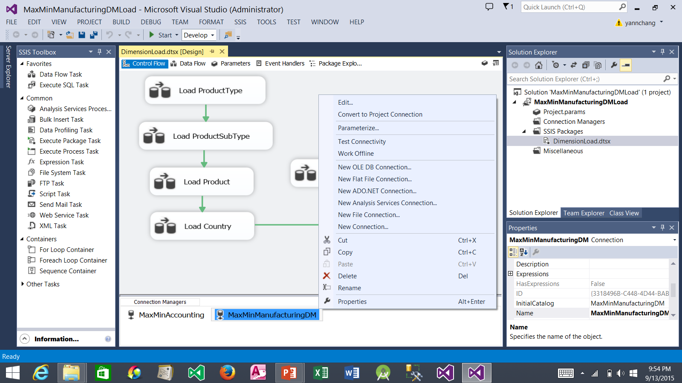
Creating a Project Connection Manager
1. Be sure that DimensionLoad.dtsx is open (in design mode).
4. Select Convert to Project Connection.
2. If DimensionLoad.dtsx is not open, double click it in the SSIS Packages folder
3. Right-click the MaxMinManufacturingDM connection.

Slide 9
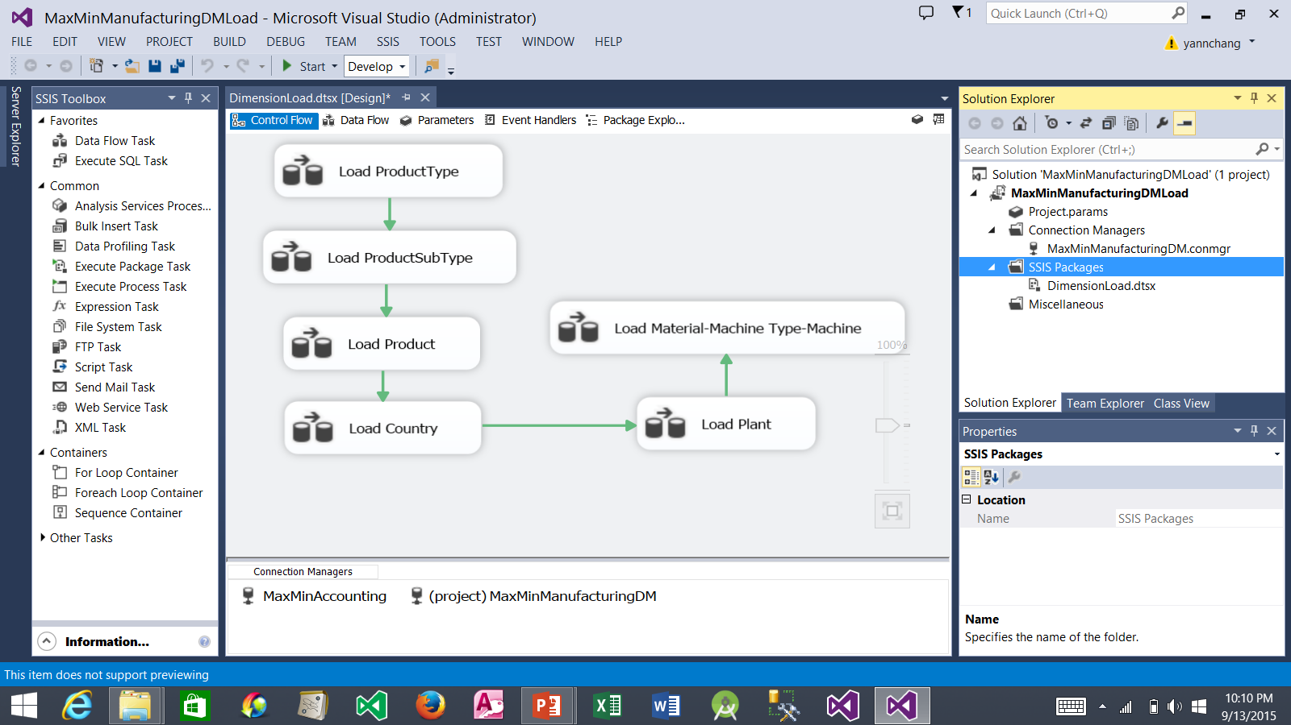
Creating a Project Connection Manager (continued)
1. The MaxMinManufacturingDM connection is moved to the Connection Managers folder.
2. The connection name is preceded by (project) to indicate it is a link to a project connection, not a package connection.

Slide 10
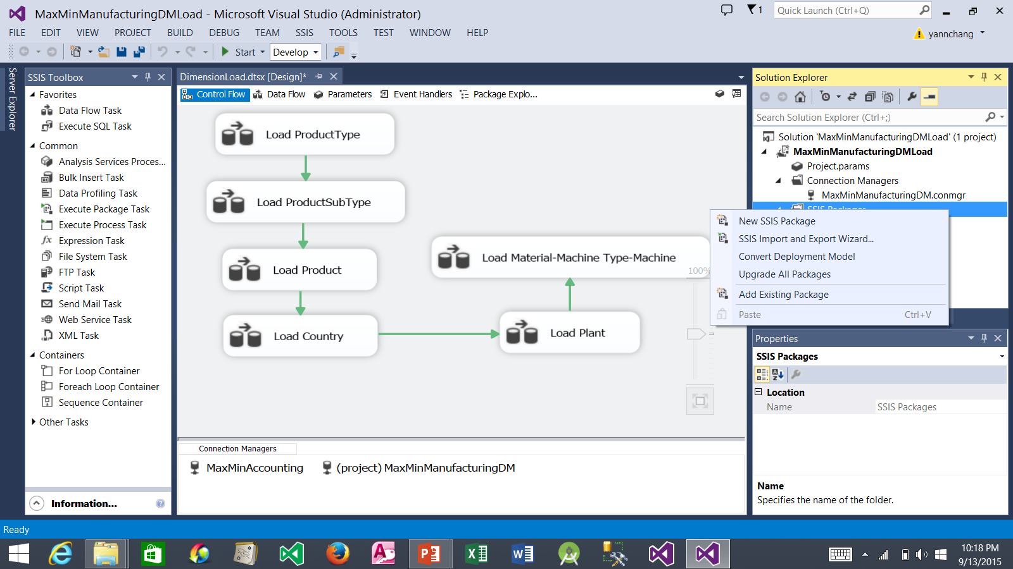
Creating the Load DimBatch Data Flow
1. Right-click the SSIS Package folder and select New SSIS Package.

Slide 11
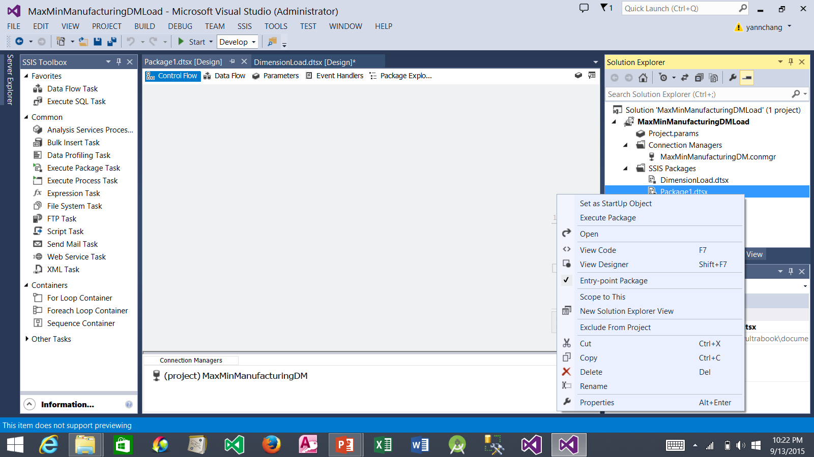
Creating the Load DimBatch Data Flow (continued)
1. Right-click Package1.dtsx and select Rename. Rename Package1.dtsx to FactLoad.dtsx.

Slide 12
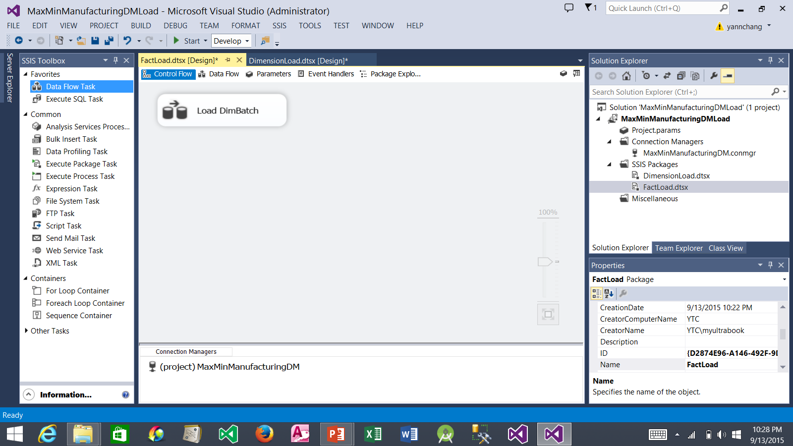
Creating the Load DimBatch Data Flow (continued)
2. Rename it to Load DimBatch. Double click it. This takes you to the Data Flow tab.
1. Drag a Data Flow Task and drop it on the Control Flow tab.

Slide 13
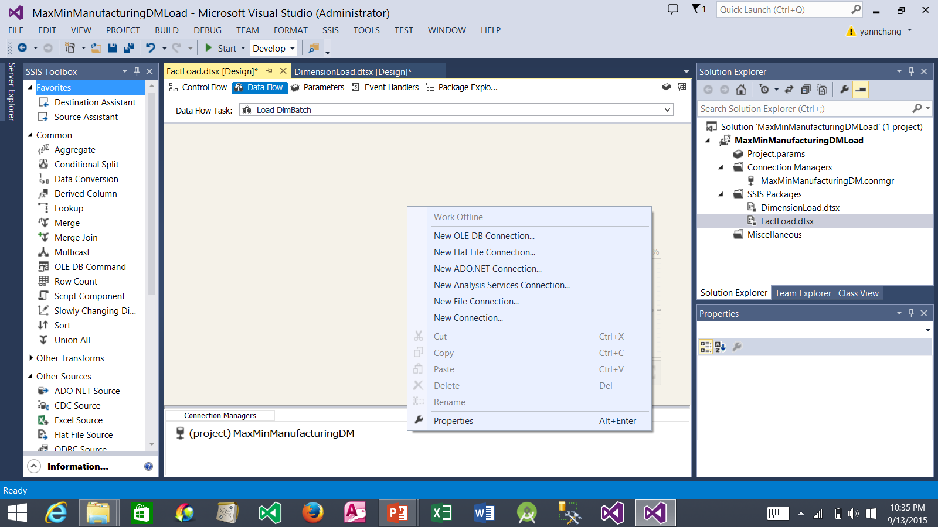
Creating the Load DimBatch Data Flow (continued)
2. Select New Flat File Connection…
1. Right-click in the Connections tray.

Slide 14
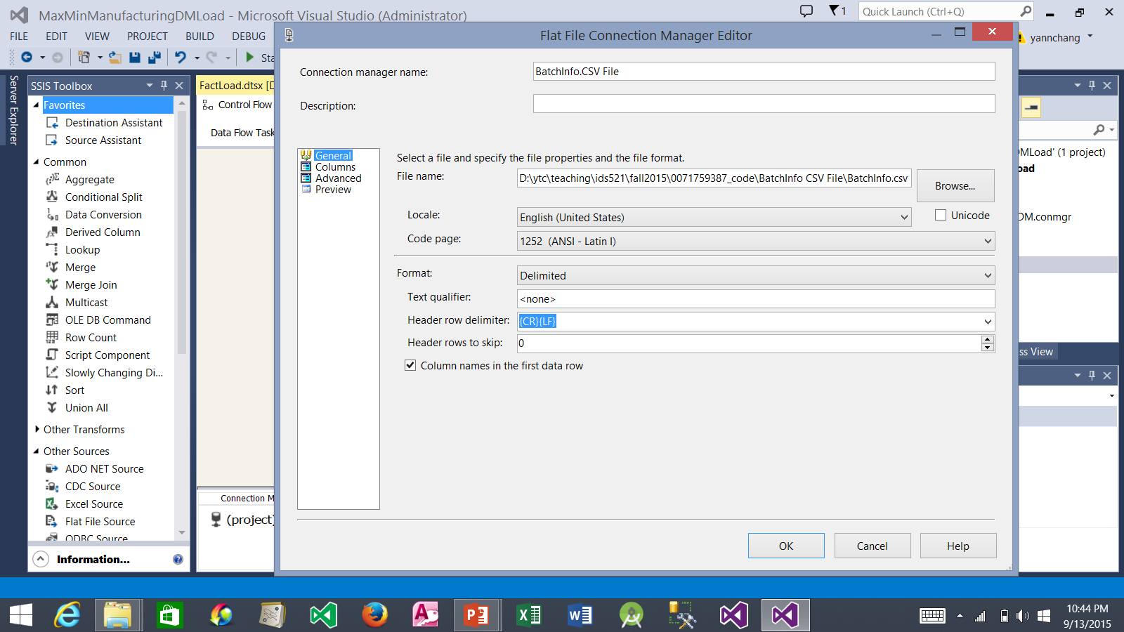
Creating the Load DimBatch Data Flow (continued)
1. Type BatchInfo.CSV File for the connection manager name.
4. Select Columns.
2. Click the Browse… button. Select CSV Files (*.csv) in the file type drop-down list in the Open dialog box. Navigate to the folder that contains BatchInfo.csv file and select it. Click Open to exit the Open dialog box.
3. Be sure that this box is checked.

Slide 15
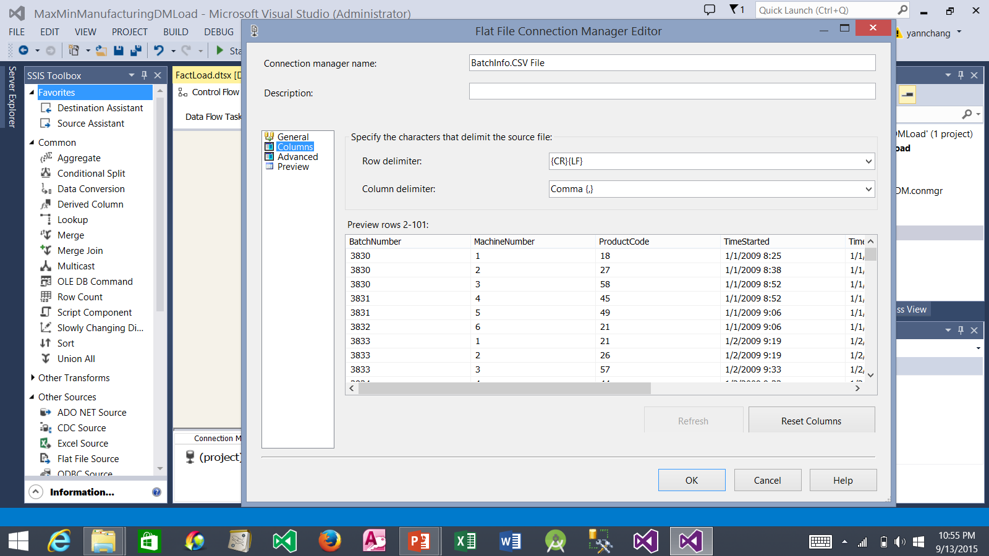
Creating the Load DimBatch Data Flow (continued)
1. Note the content of the columns being read from the BatchInfo.CSV text file.
2. Select Advanced

Slide 16
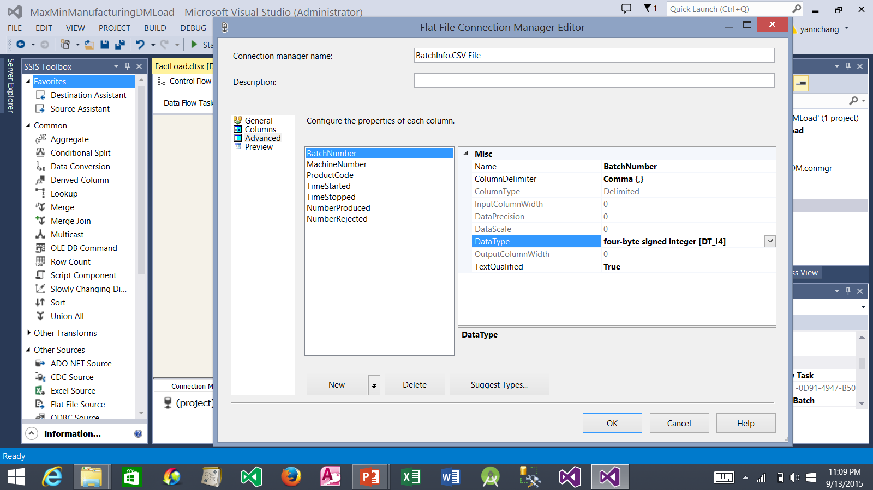
Creating the Load DimBatch Data Flow (continued)
2. Change the data type to four-byte signed integer [DT_14]
3. Similarly, change the data type for the MachineNumber, ProductCode, NumberProduced, and NumberRejected columns to four-byte signed integer [DT_14].
1. Select BatchNumber
4. Similarly, change the data type for the TimeStarted and TimeStopped columns to database timestamp [DT_DBTIMESTAMP].
5. Click the OK button.

Slide 17
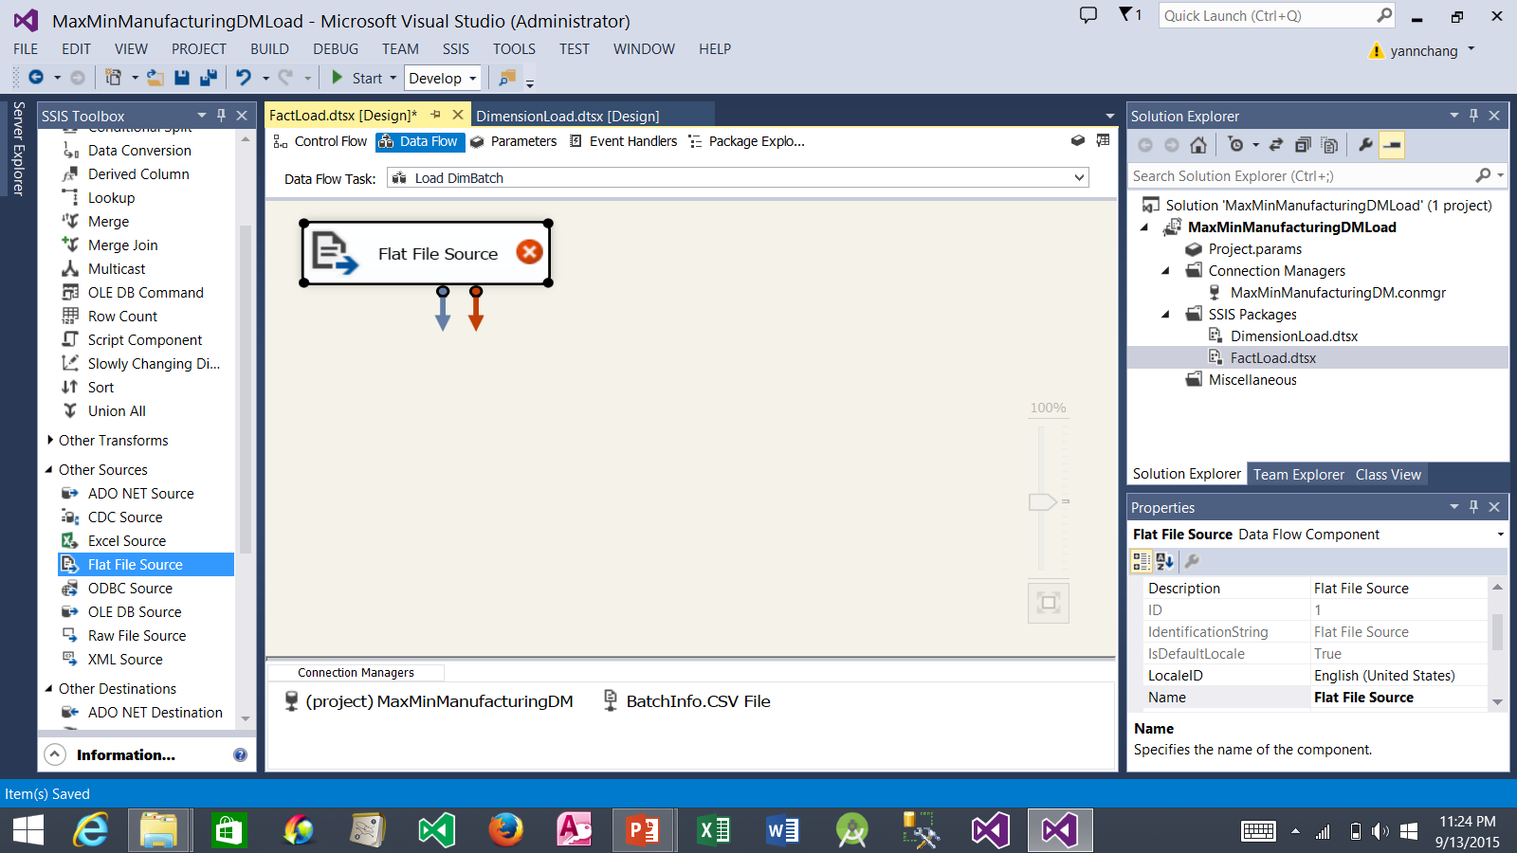
Creating the Load DimBatch Data Flow (continued)
2. Drop it here. Double click it to open a dialog box.
1. Drag a Flat File Source.

Slide 18
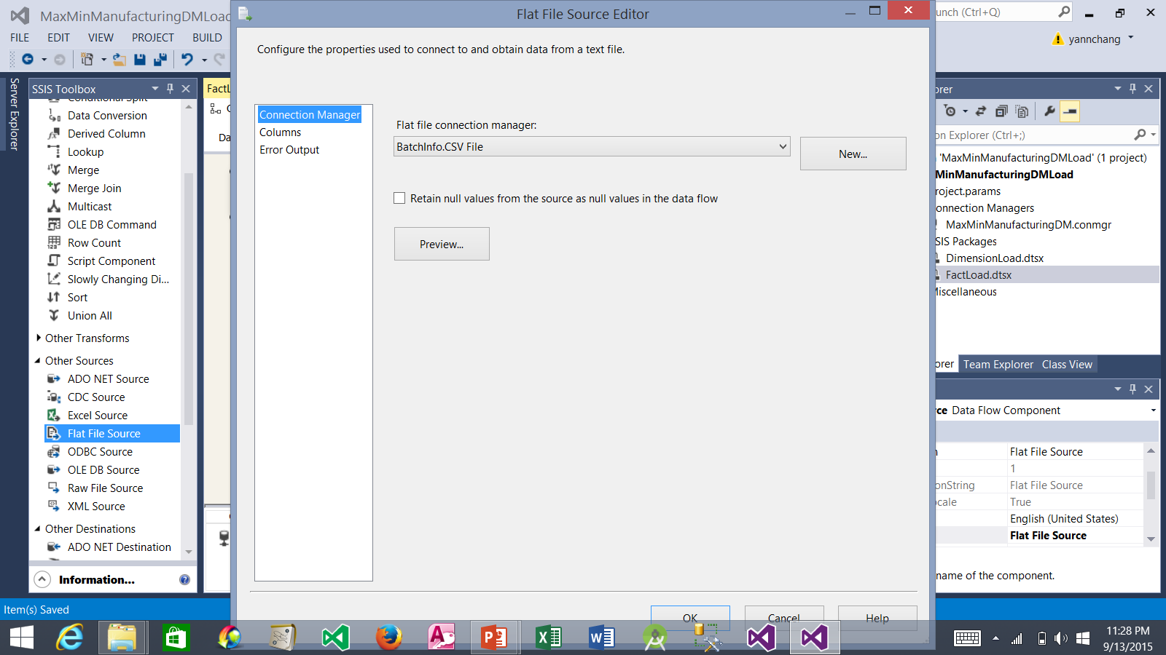
Creating the Load DimBatch Data Flow (continued)
1. Be sure that BatchInfo.CSV File is selected.
2. Select Columns.

Slide 19
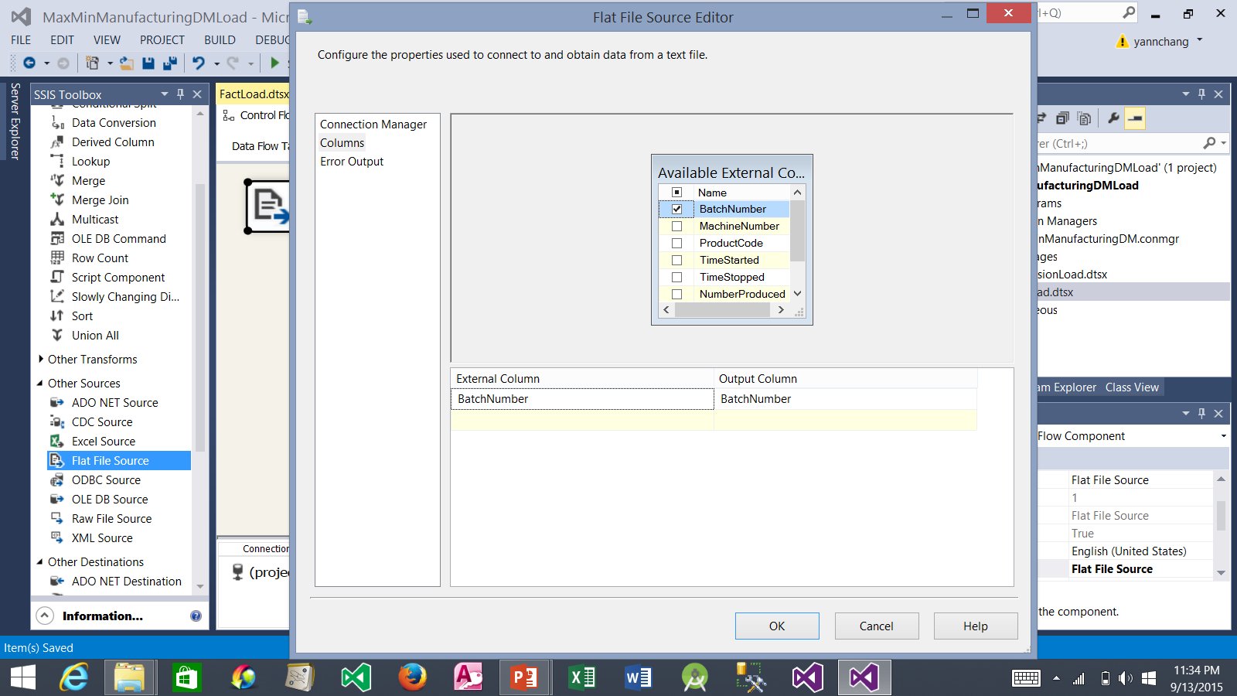
Creating the Load DimBatch Data Flow (continued)
1. Uncheck all of the columns except the BatchNumber column.
2. Click the OK button.

Slide 20
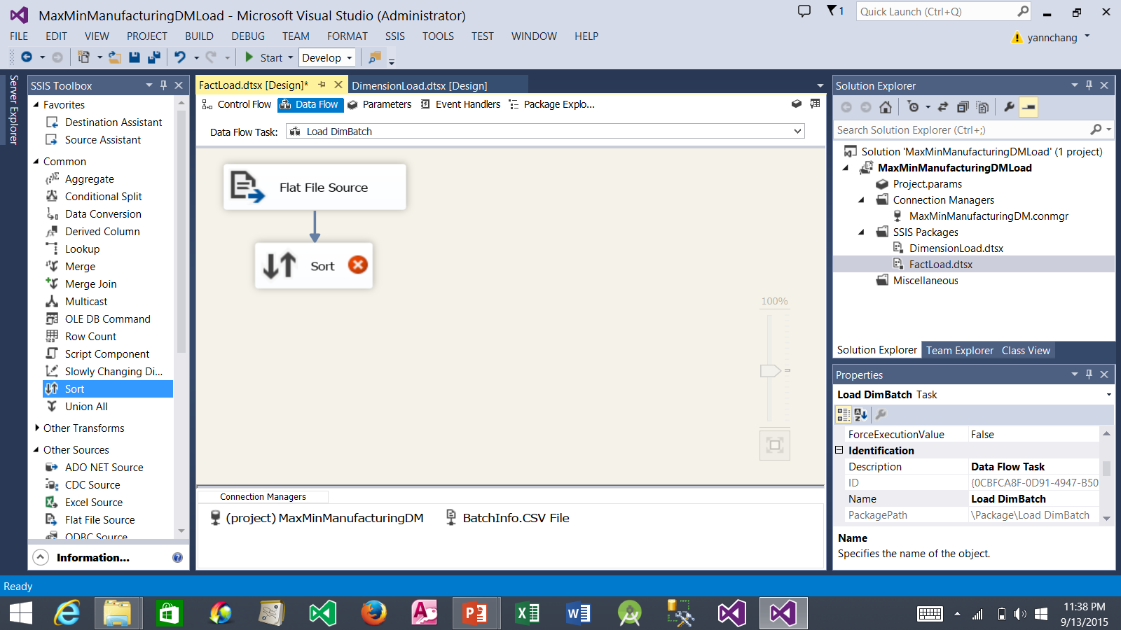
Creating the Load DimBatch Data Flow (continued)
2. Click it. Drag the blue arrow and drop it on top of the Sort item. This connect the Flat File Source item to the Sort item.
3. Double click it. The Sort Transformation Editor window appears.
1. Drag a Sort item and drop it here.

Slide 21
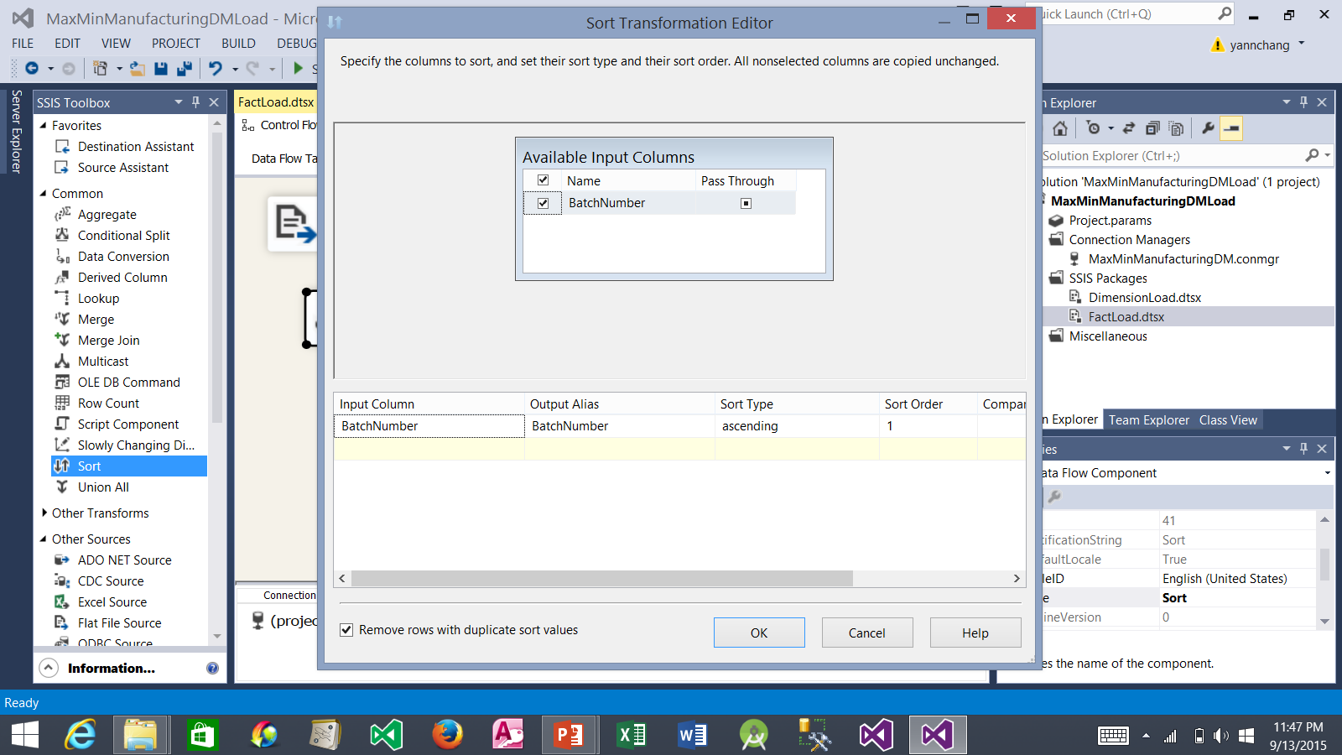
Creating the Load DimBatch Data Flow (continued)
1. Check the box to the left of BatchNumber.
2. Check the box here.
3. Click the OK button.

Slide 22
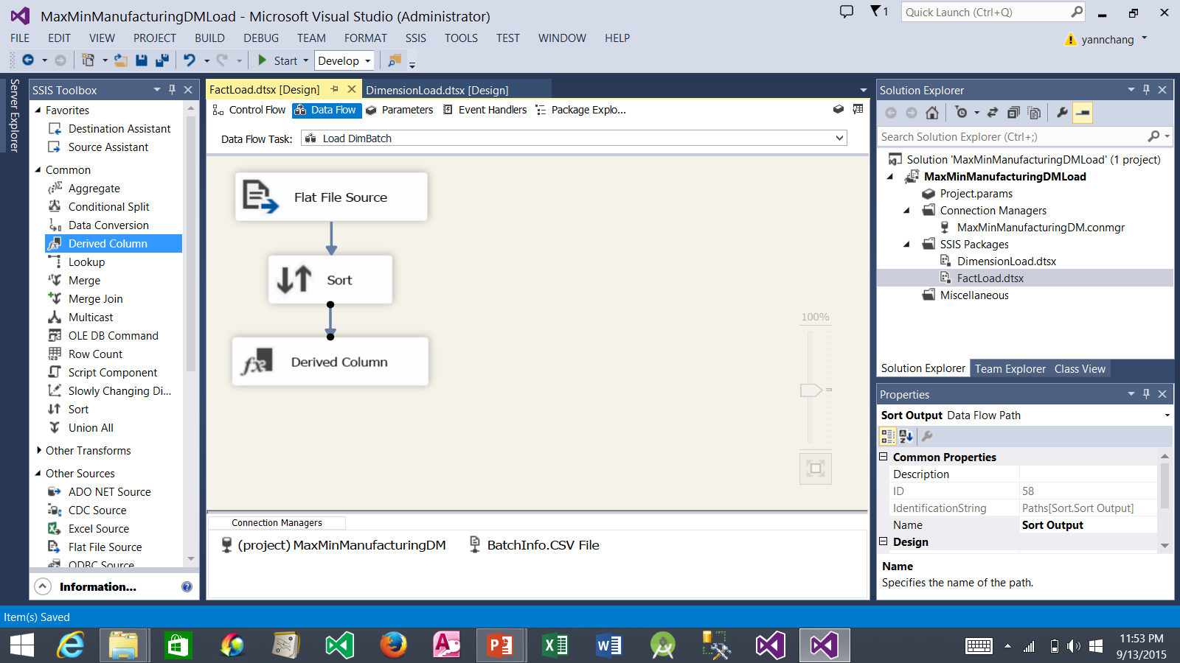
Creating the Load DimBatch Data Flow (continued)
2. Click it. Drag the blue arrow and drop it on top of the Derived Column item. This connect the Sort item to the Derived Column item.
3. Double click it. The Derived Column Transformation Editor window appears.
1. Drag a Derived Column item and drop it here.

Slide 23
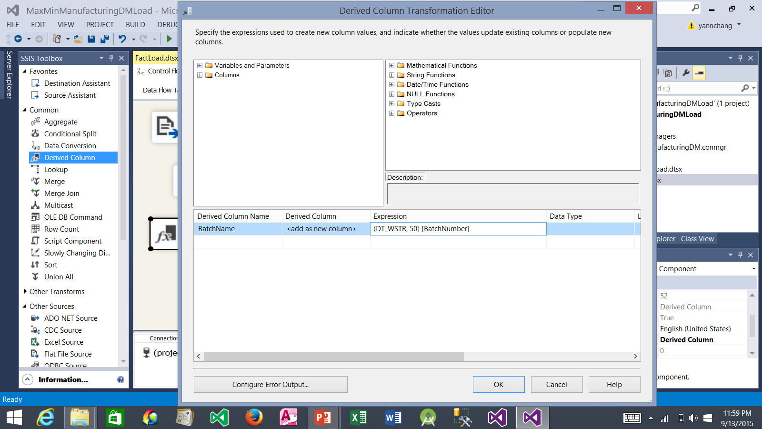
Creating the Load DimBatch Data Flow (continued)
1. Type BatchName here.
2. Type as shown here.
3. Click the OK button.

Slide 24
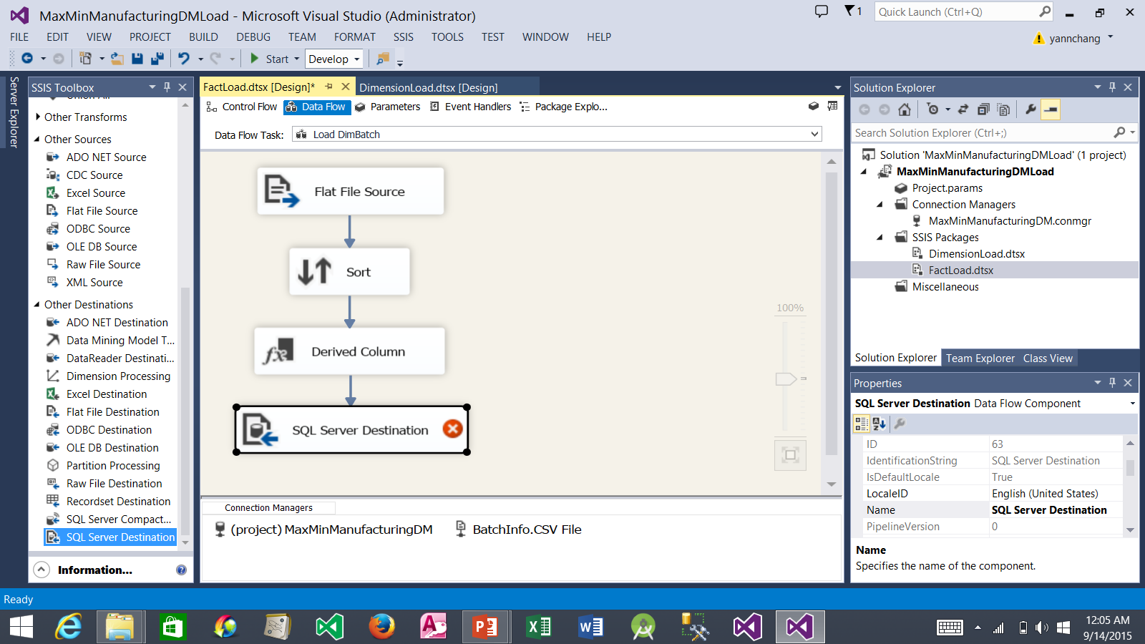
Creating the Load DimBatch Data Flow (continued)
2. Click it. Drag the blue arrow and drop it on top of SQL Server Destination item. This connects the two items.
3. Double click it. A dialog box appears.
1. Drag an SQL Server Destination item and drop it here.

Slide 25
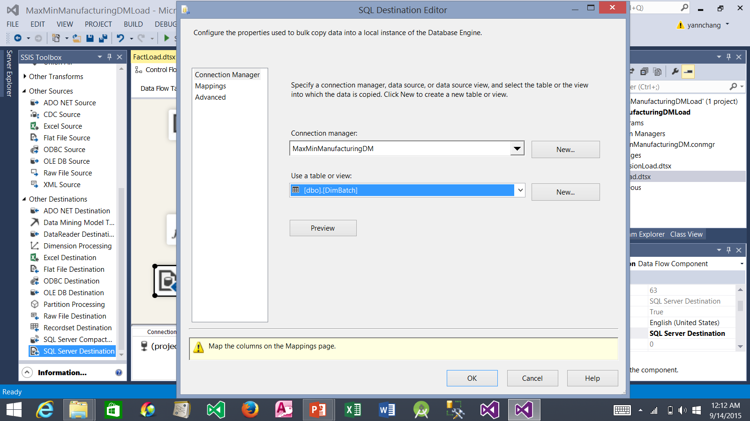
Creating the Load DimBatch Data Flow (continued)
1. Be sure that MaxMinManufacturingDM is selected.
3. Select Mappings.
2. Select dbo.DimBatch.

Slide 26
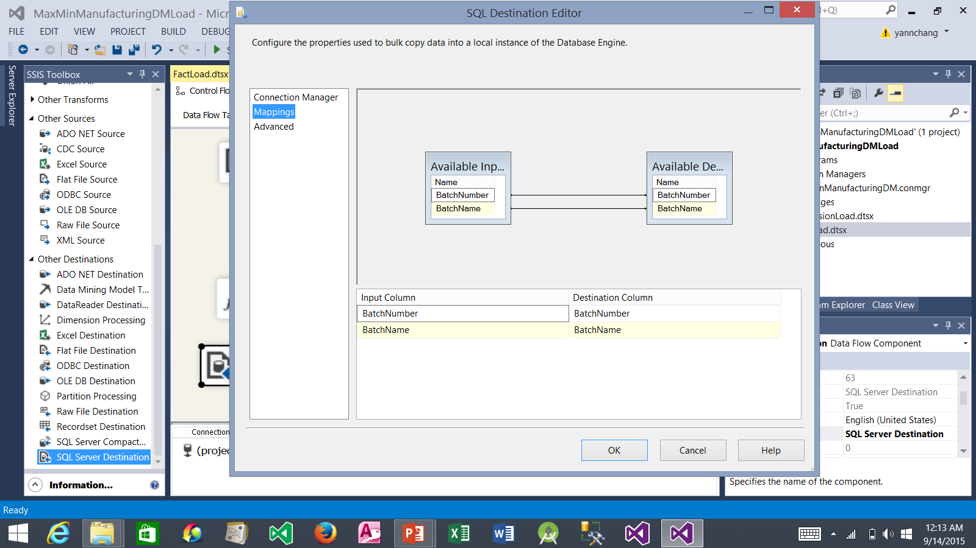
Creating the Load DimBatch Data Flow (continued)
1. The following mappings should be automatically in place.
2. Click the OK button.

Slide 27

Creating the Load DimBatch Data Flow (continued)
1. Click the Save All button.
2. At this point, the Data Flow tab should appear as show here.

Slide 28
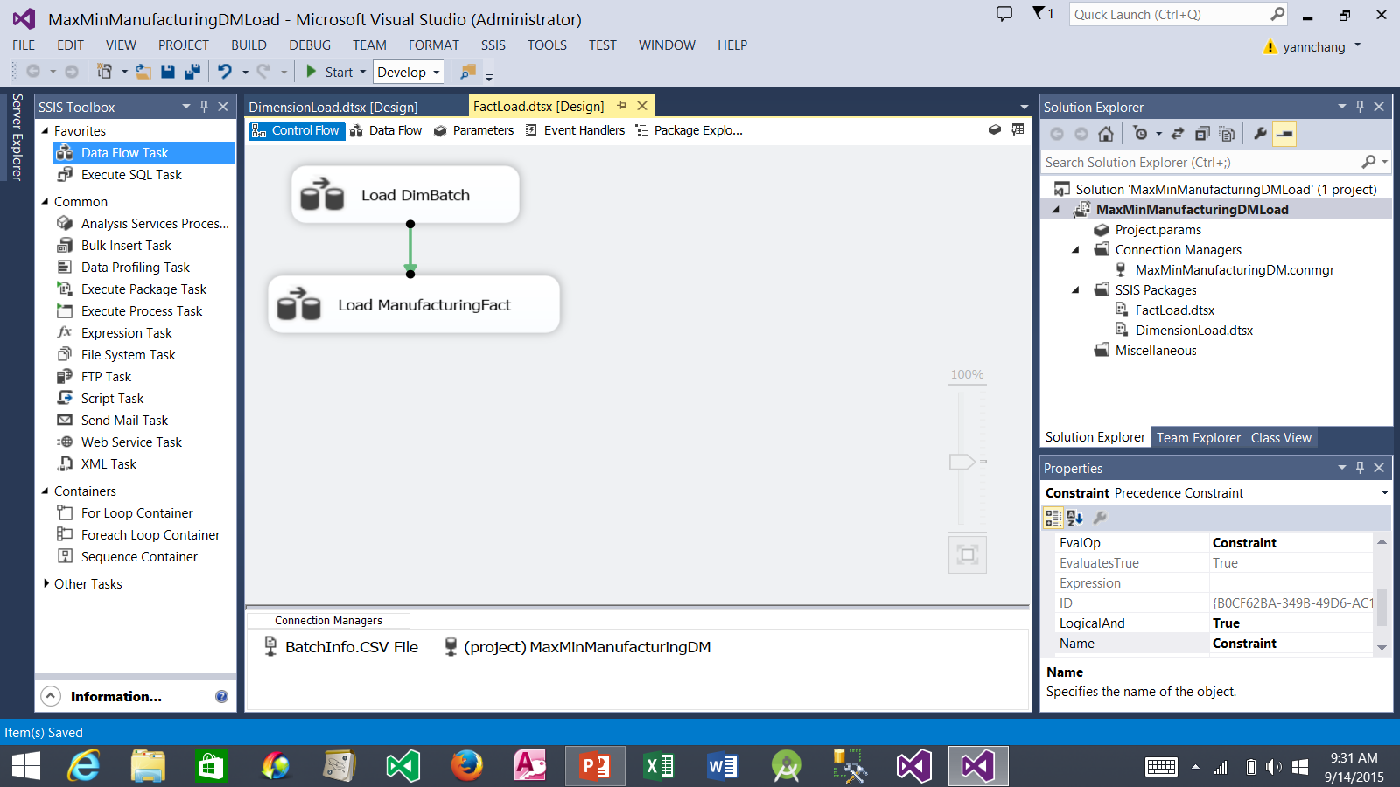
Creating the Load ManufacturingFact Data Flow
2. Select Load DimBatch. Drag the green precedence arrow and drop it on top the Load ManufacturingFact. This means the DimBatch table must be loaded successfully before the ManufacturingFact table can be loaded.
1. Drag a Data Flow Task and drop it here. Rename it to Load ManufacturingFact.
3. Double click it. This takes you to the Data Flow tab.

Slide 29
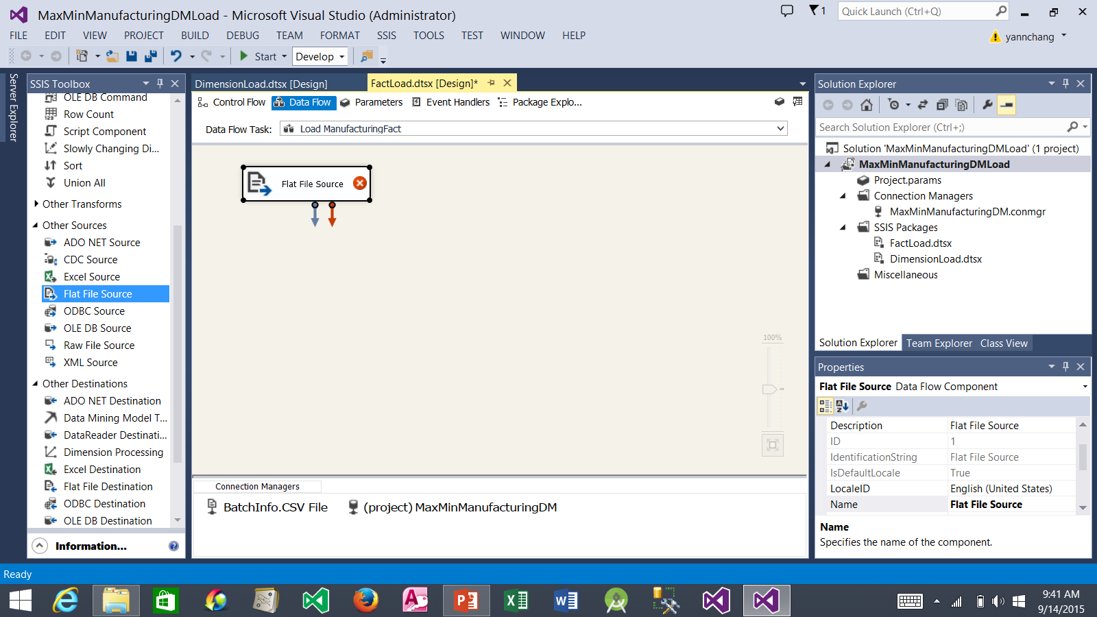
Creating the Load ManufacturingFact Data Flow (continued)
1. Drag a Flat File Source item and drop it here. Double click it. The Flat File Source Editor dialog box appears.

Slide 30
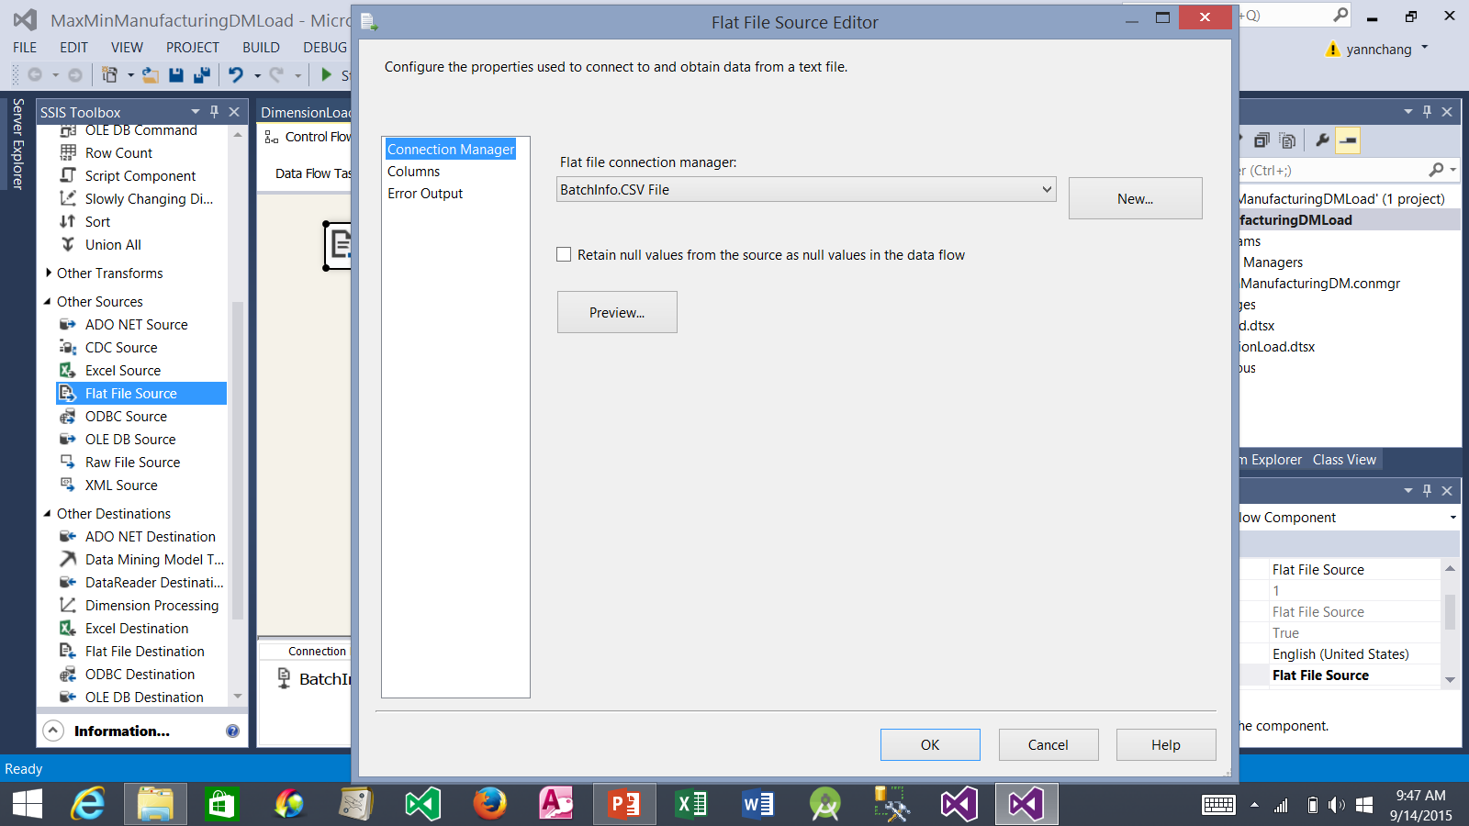
Creating the Load ManufacturingFact Data Flow (continued)
1. Be sure that BatchInfo.CSV File connection manager is selected from the drop-down list.
2. Click the OK button.

Slide 31
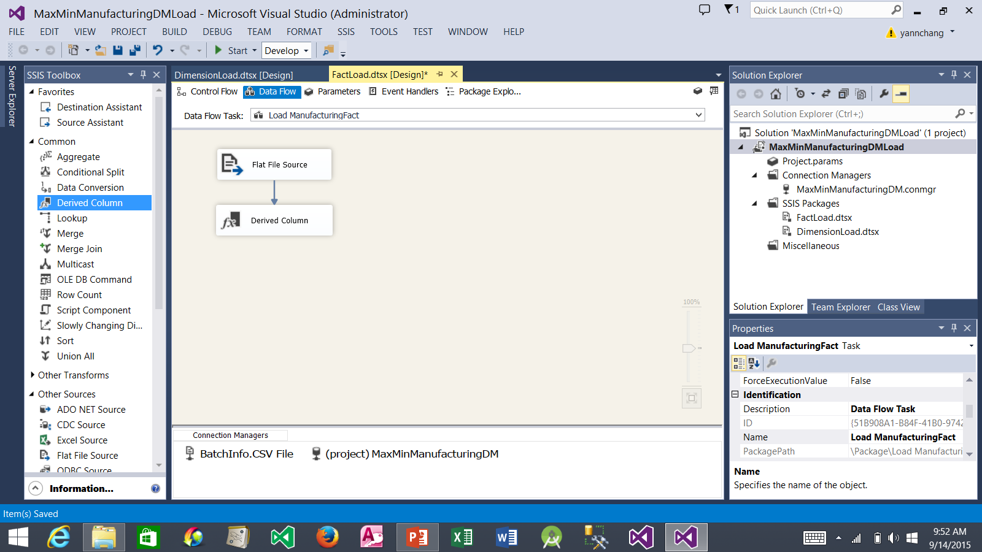
Creating the Load ManufacturingFact Data Flow (continued)
2. Select it. Drag the blue data flow arrow and drop it on top of the Derived Column item. This connect the source to the transformation.
3. Double click it. The Derived Column Transformation Editor dialog box appears.
1. Drag a Derived Column item and drop it here.

Slide 32
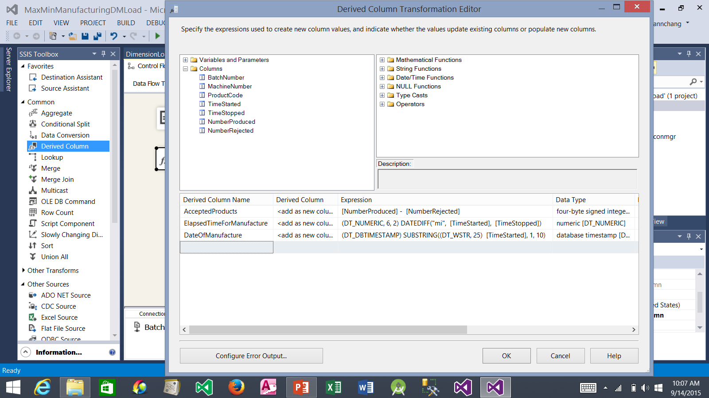
Creating the Load ManufacturingFact Data Flow (continued)
1. Expand the Columns node so that you can see the available columns.
2. Enter three derived column names and their corresponding expressions as shown. Note: the Data Type column would be automatically populated.
3. Click the OK button.

Slide 33

Creating the Load ManufacturingFact Data Flow (continued)
2. Select it. Drag the blue data flow arrow and drop it on top of the Lookup Batch Number item.
3. Double click it. The Lookup Transformation Editor dialog box appears.
1. Drag a Lookup item and drop it here. Rename it to Lookup Batch Number.

Slide 34
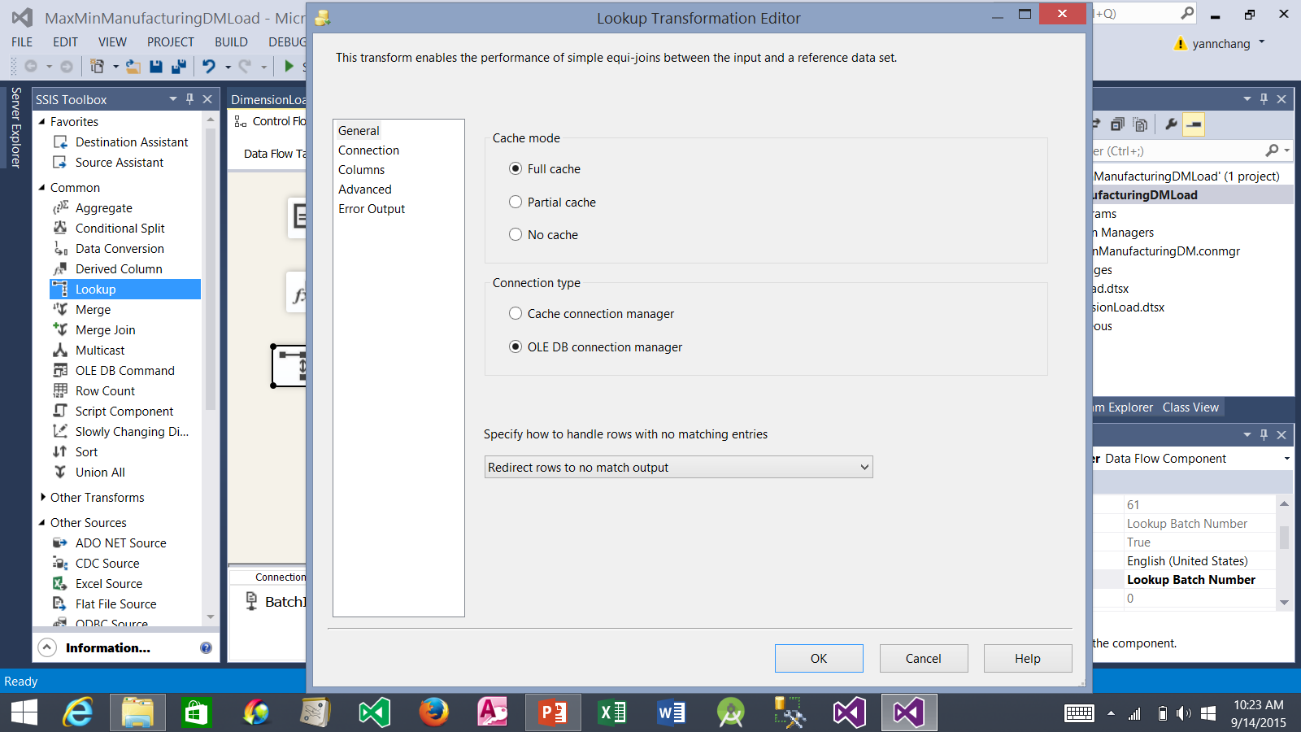
Creating the Load ManufacturingFact Data Flow (continued)
1. Select Redirect rows to no match output.
2. Select Connection to view the Connection page.

Slide 35
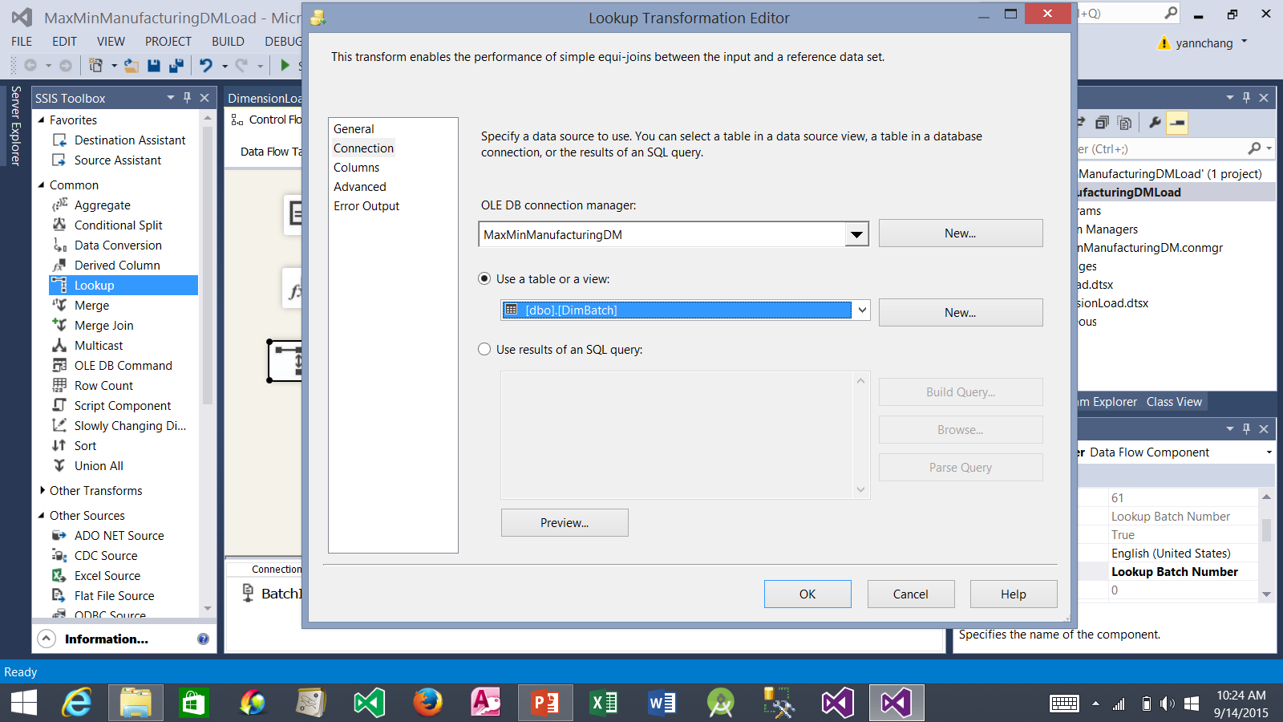
Creating the Load ManufacturingFact Data Flow (continued)
1. Select dbo.DimBatch.
2. Select Columns to view the Columns page.

Slide 36
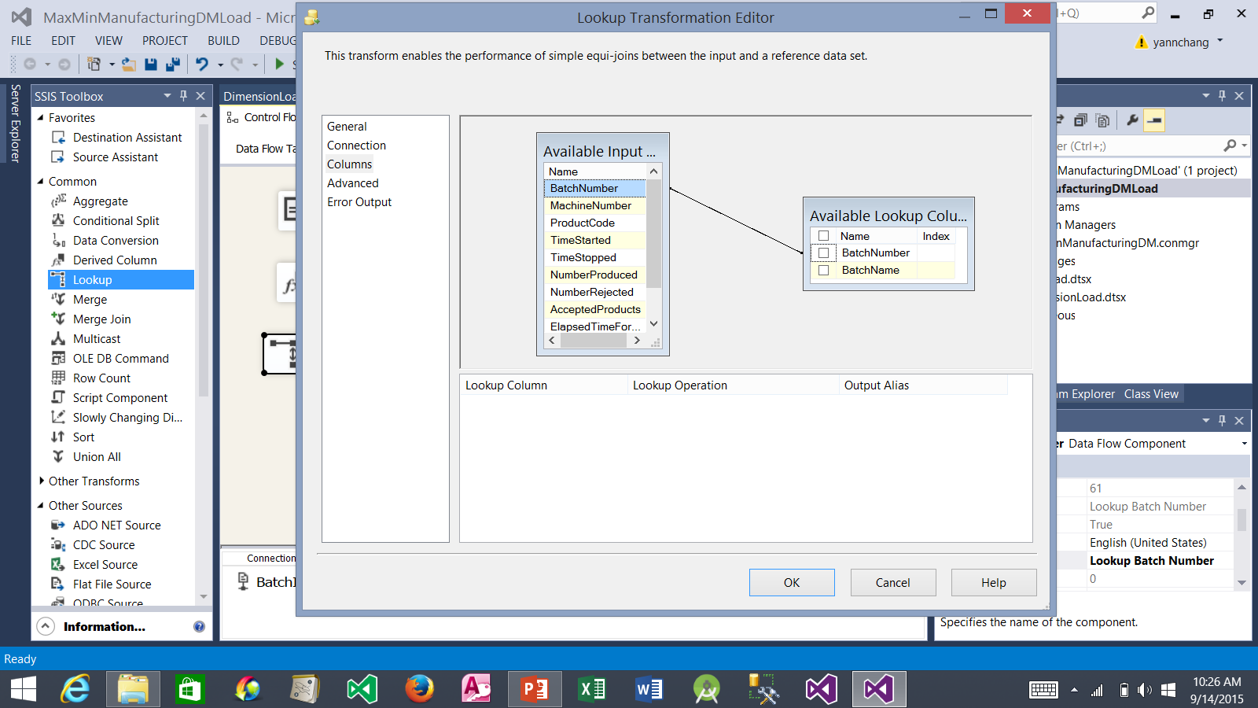
Creating the Load ManufacturingFact Data Flow (continued)
1. Drag the BatchNumber column from the Available Input Columns list and drop it on BatchNumber in the Available LookupColumns list.
2. Click the OK button.

Slide 37
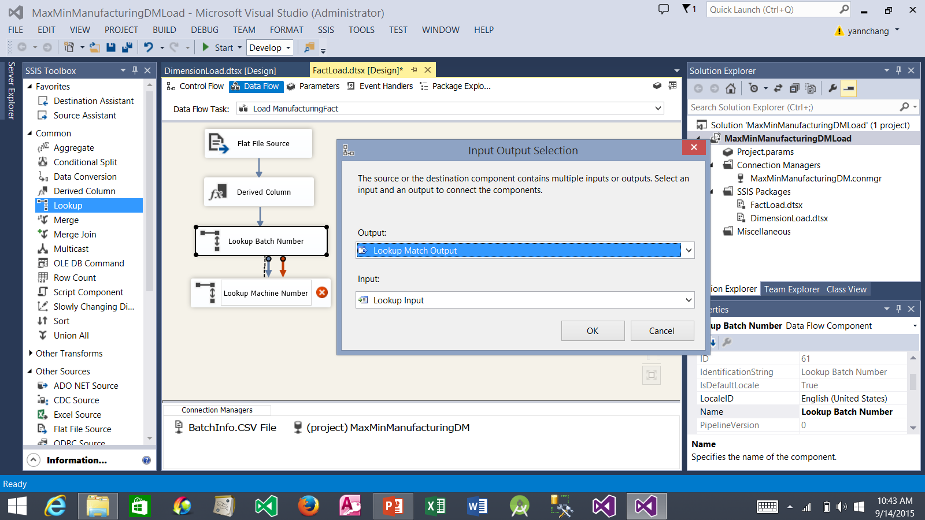
Creating the Load ManufacturingFact Data Flow (continued)
2. Select it. Drag the blue data flow arrow and drop it on top of the Lookup Machine Number item.
3. The Input Output Selection window appear. Select Lookup Match Output.
1. Drag another Lookup item and drop it here. Rename it to Lookup Machine Number.
5. Double click it. The Lookup Transformation Editor appears.
4. Click the OK button.

Slide 38
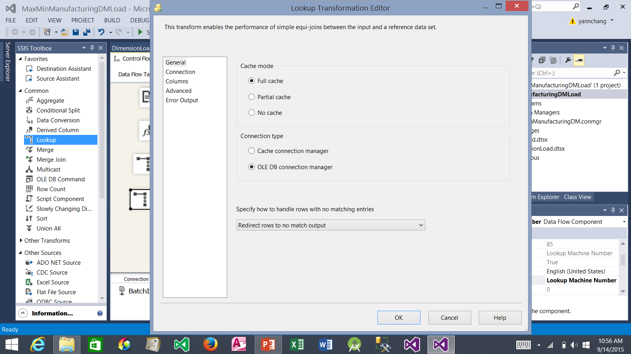
Creating the Load ManufacturingFact Data Flow (continued)
2. Select Connection to view the Connection page.
1. Select Redirect rows to no match output.

Slide 39
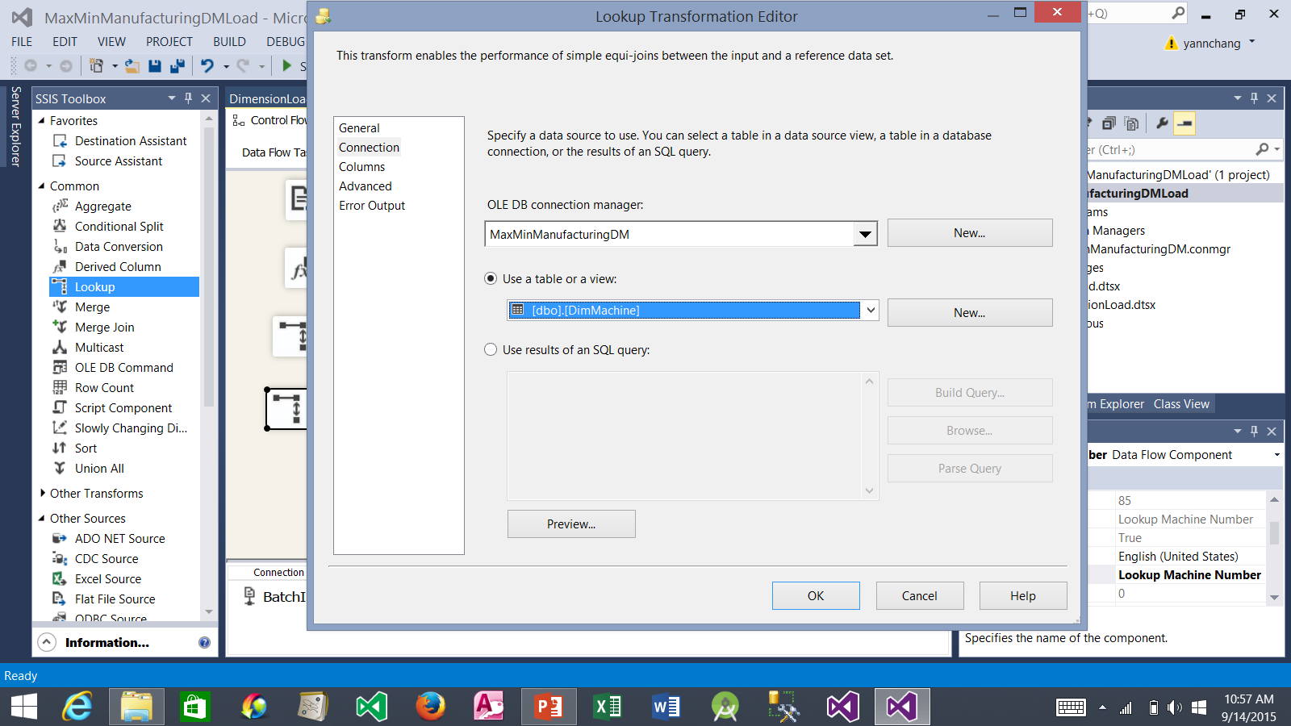
Creating the Load ManufacturingFact Data Flow (continued)
1. Select dbo.DimMachine.
2. Select Columns to view the Columns page.

Slide 40

Creating the Load ManufacturingFact Data Flow (continued)
1. Drag the MachineNumber column from the Available Input Columns list and drop it on MachineNumber in the Available LookupColumns list.
2. Click the OK button.

Slide 41
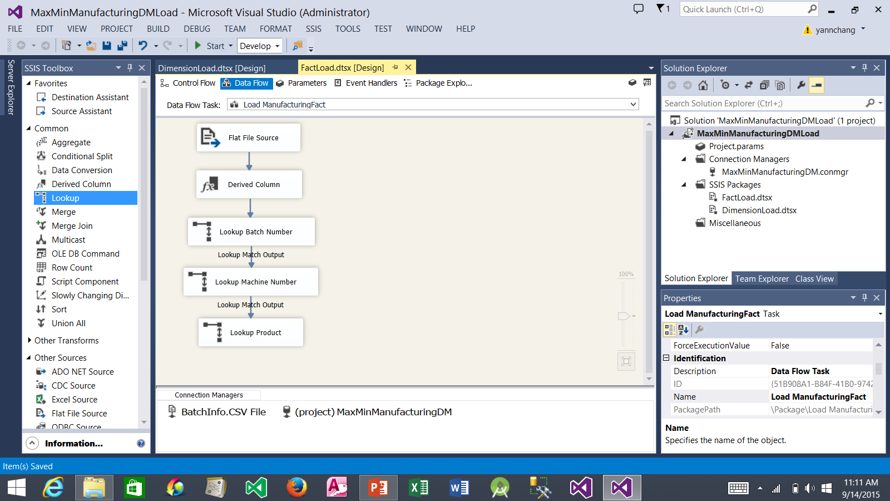
Creating the Load ManufacturingFact Data Flow (continued)
Repeat the steps on Slides 37 to 40 to add the following Lookup item to the Data Flow:
Item name: Lookup Product
Table: dbo.DimProduct
Available Input Column: ProductCode
Available Lookup Column: ProductCode.

Slide 42
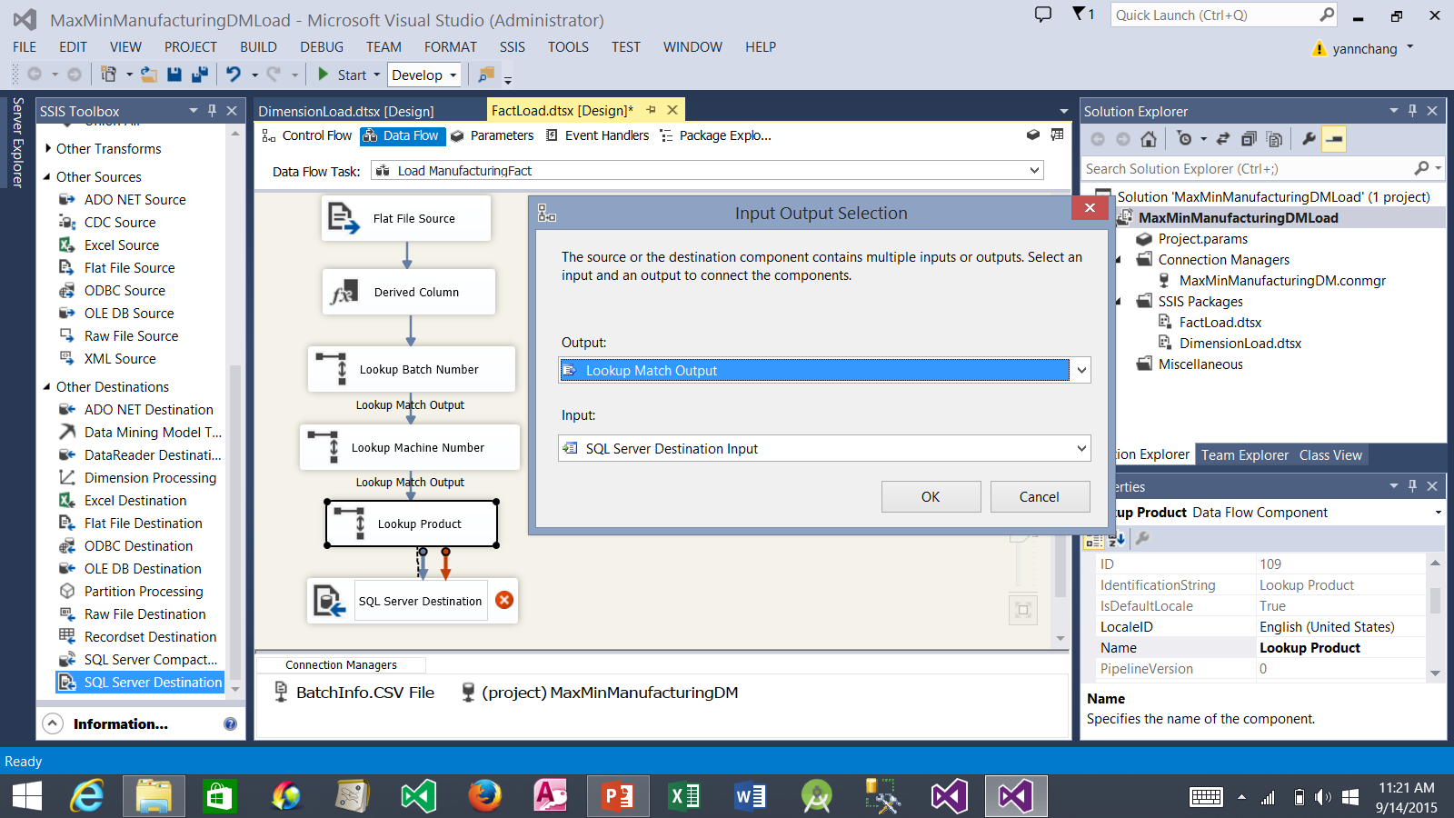
Creating the Load ManufacturingFact Data Flow (continued)
2. Select it. Drag the blue data flow arrow and drop it on top of the SQL Server Destination item.
3. The Input Output Selection window appear. Select Lookup Match Output.
1. Drag a SQL Server Destination and drop it here.
4. Click the OK button.
5. Double click it. The SQL Server Destination Editor appears.

Slide 43
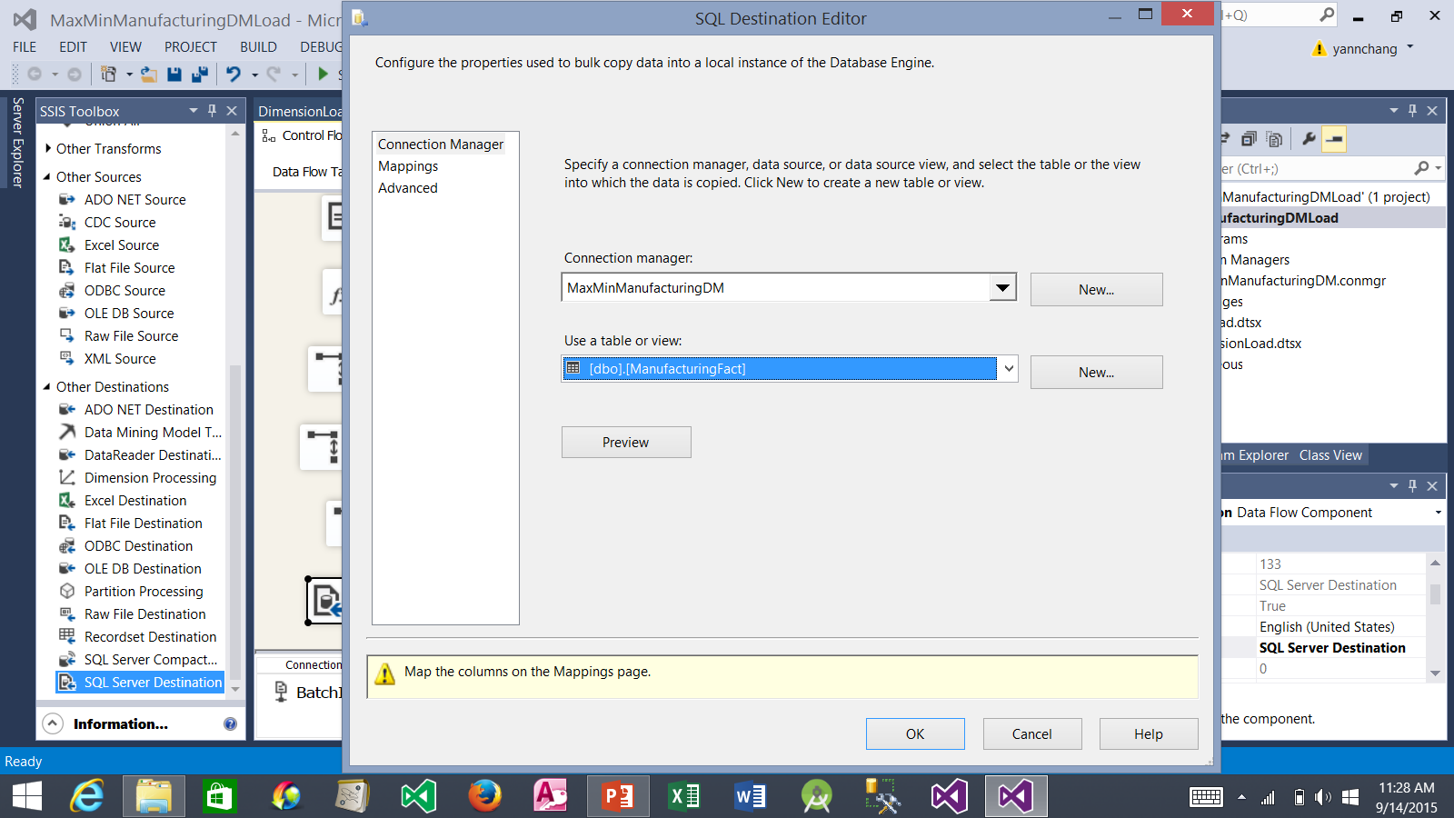
Creating the Load ManufacturingFact Data Flow (continued)
1. Select dbo.ManufacturingFact.
2. Select Mappings to view the Mappings page.

Slide 44
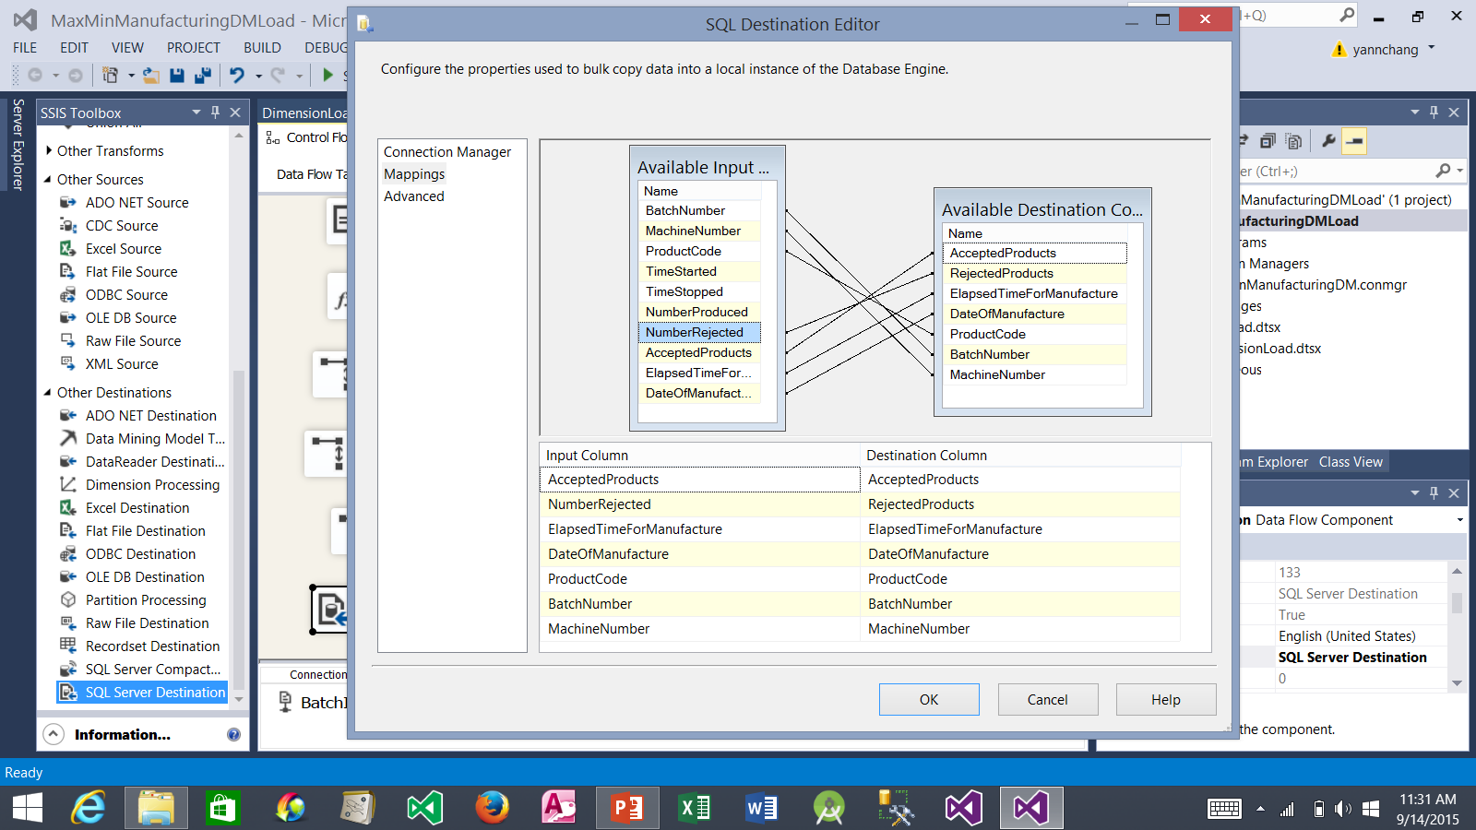
Creating the Load ManufacturingFact Data Flow (continued)
Most of the columns from the Available Input Columns list should be automatically mapped to the corresponding columns in the Available Destination Columns list. Add one more column mapping: Drag NumberRejected and drop it on RejectedProducts.
2. Click the OK button.

Slide 45
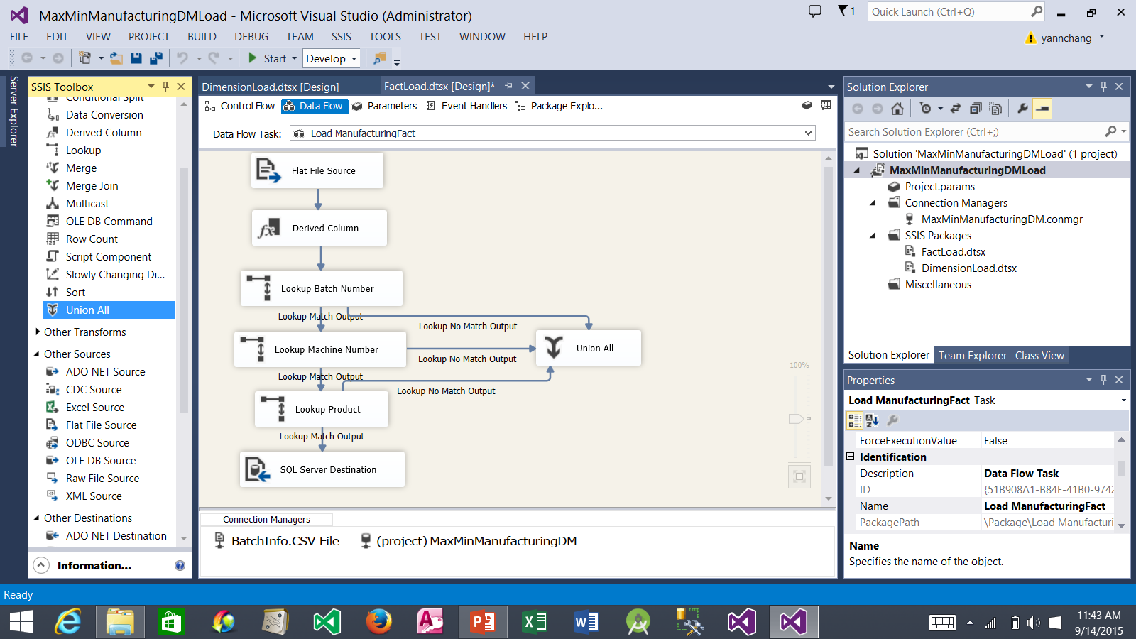
Creating the Load ManufacturingFact Data Flow (continued)
2. Select the Lookup Batch Number item. Drag the unattached blue data flow arrow and drop it on the Union All item. Repeat this process with Lookup Machine Number and Lookup Product items.
Drag a Union All item and drop it here.

Slide 46
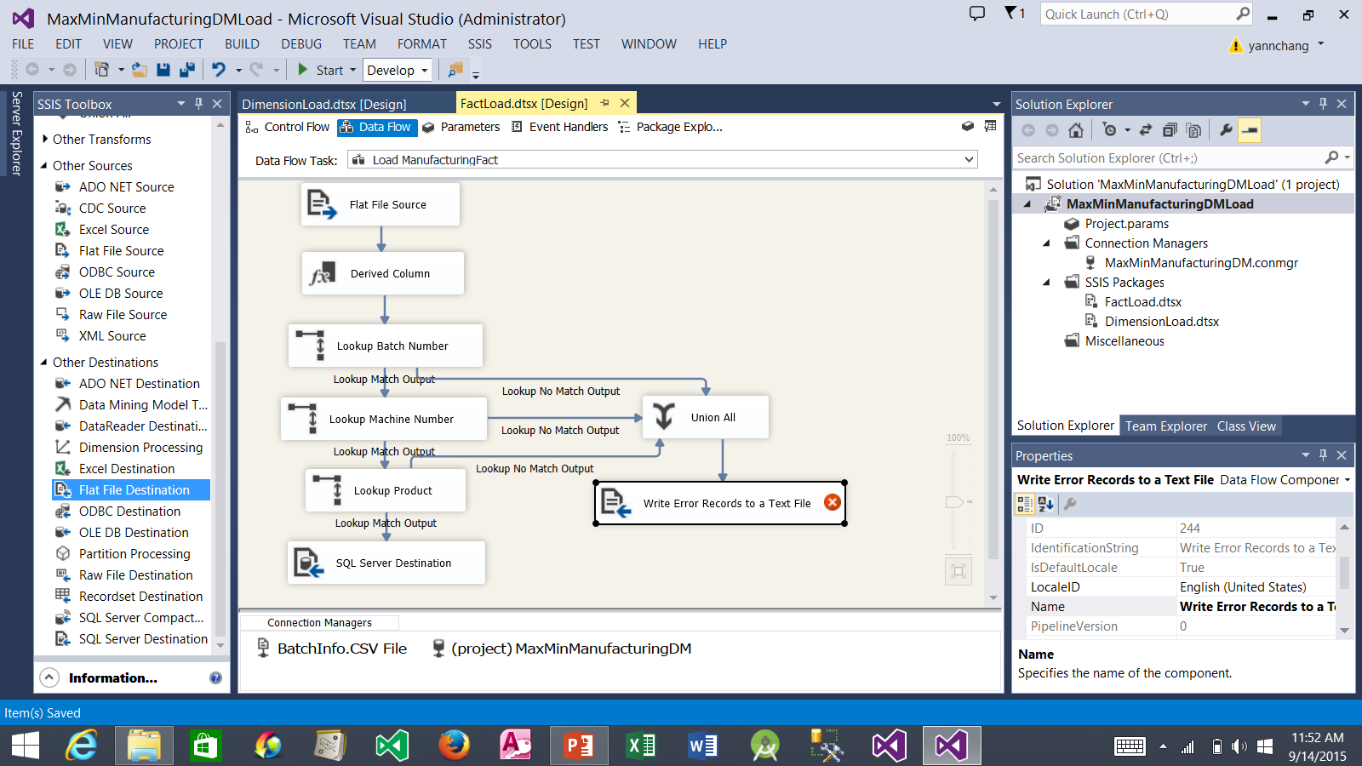
Creating the Load ManufacturingFact Data Flow (continued)
2. Select Union All item. Drag the blue data flow arrow and drop it on the Write Error Records item.
3. Double click it. The Flat File Destination Editor window appears.
1. Drag a Flat File Destination and drop it here. Rename it as shown.

Slide 47
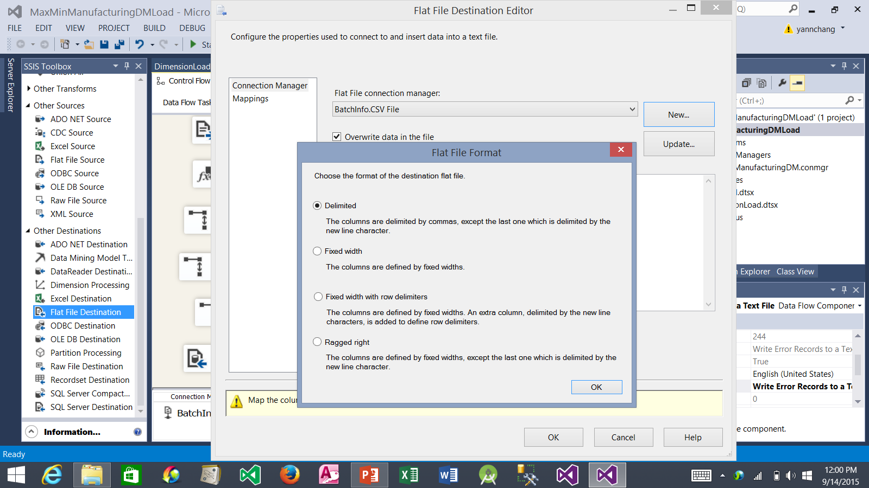
Creating the Load ManufacturingFact Data Flow (continued)
1. Click the New button to create a new connection for the errors output.
2. Flat File Format window appears.
3. Be sure that Delimited is selected.
4. Click the OK button.

Slide 48
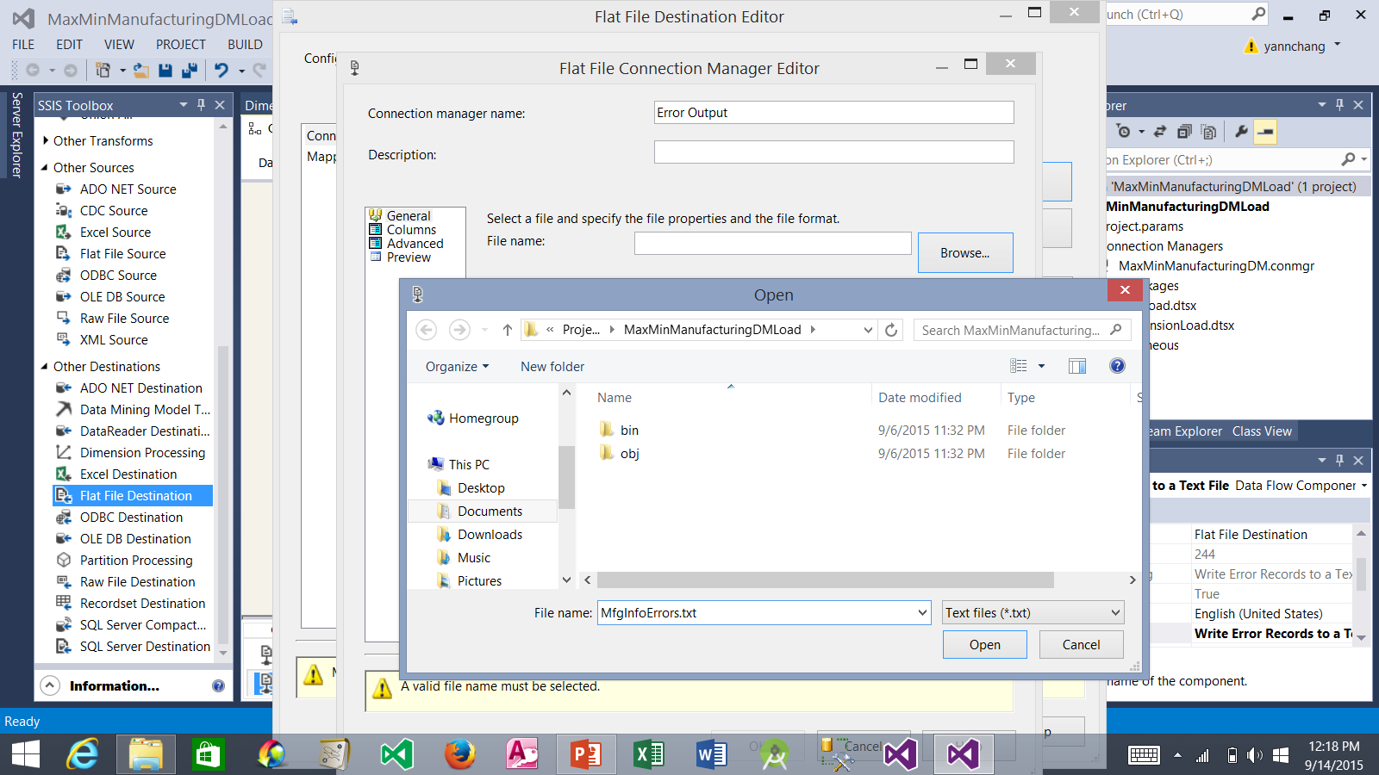
Creating the Load ManufacturingFact Data Flow (continued)
1. Type Error Output for the Connection manager name.
2. Click the Browse button.
3. You can store the error output in any folder. However, it is easier to find if you store it in the same folder where you created the MaxMinManufacturingDMLoad project.
4. Type MfgInfoErrors.txt for the file name.
5. Click the Open button.

Slide 49
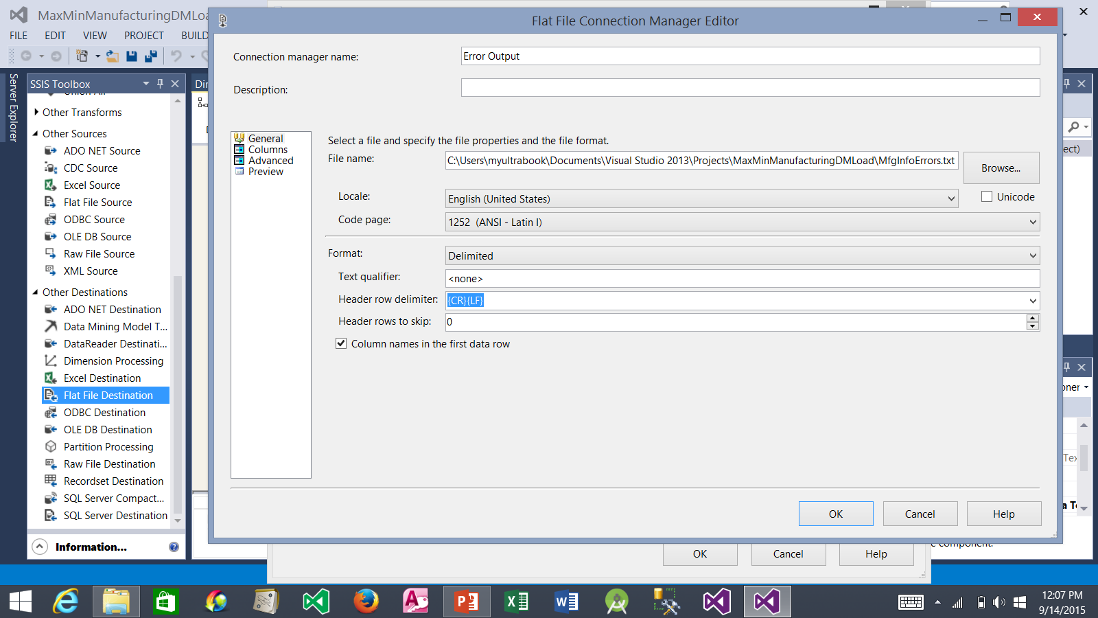
Creating the Load ManufacturingFact Data Flow (continued)
1. Be sure to check this box.
2. Click the OK button.

Slide 50
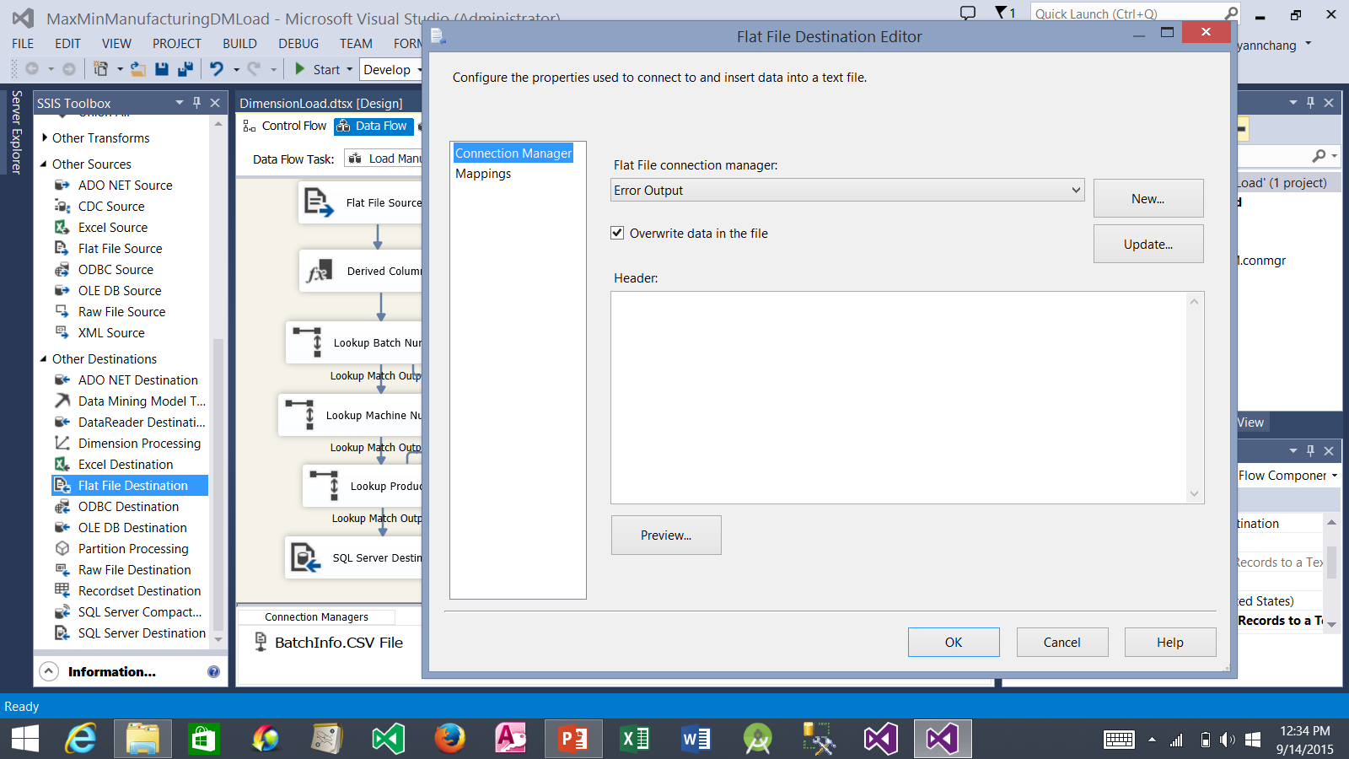
Creating the Load ManufacturingFact Data Flow (continued)
1. Click Mappings to view the Mappings page.

Slide 51
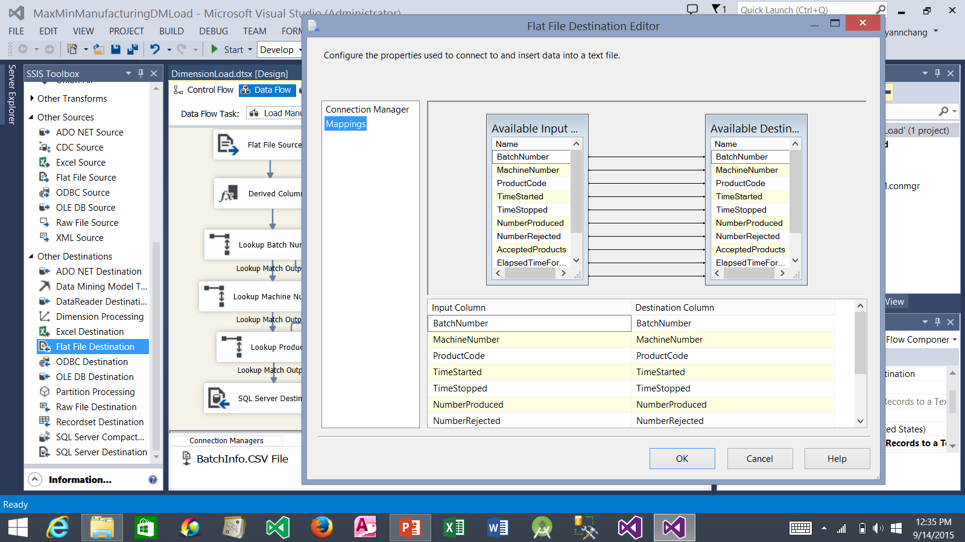
Creating the Load ManufacturingFact Data Flow (continued)
1. Mappings have been automatically created for all columns
2. Click the OK button.

Slide 52
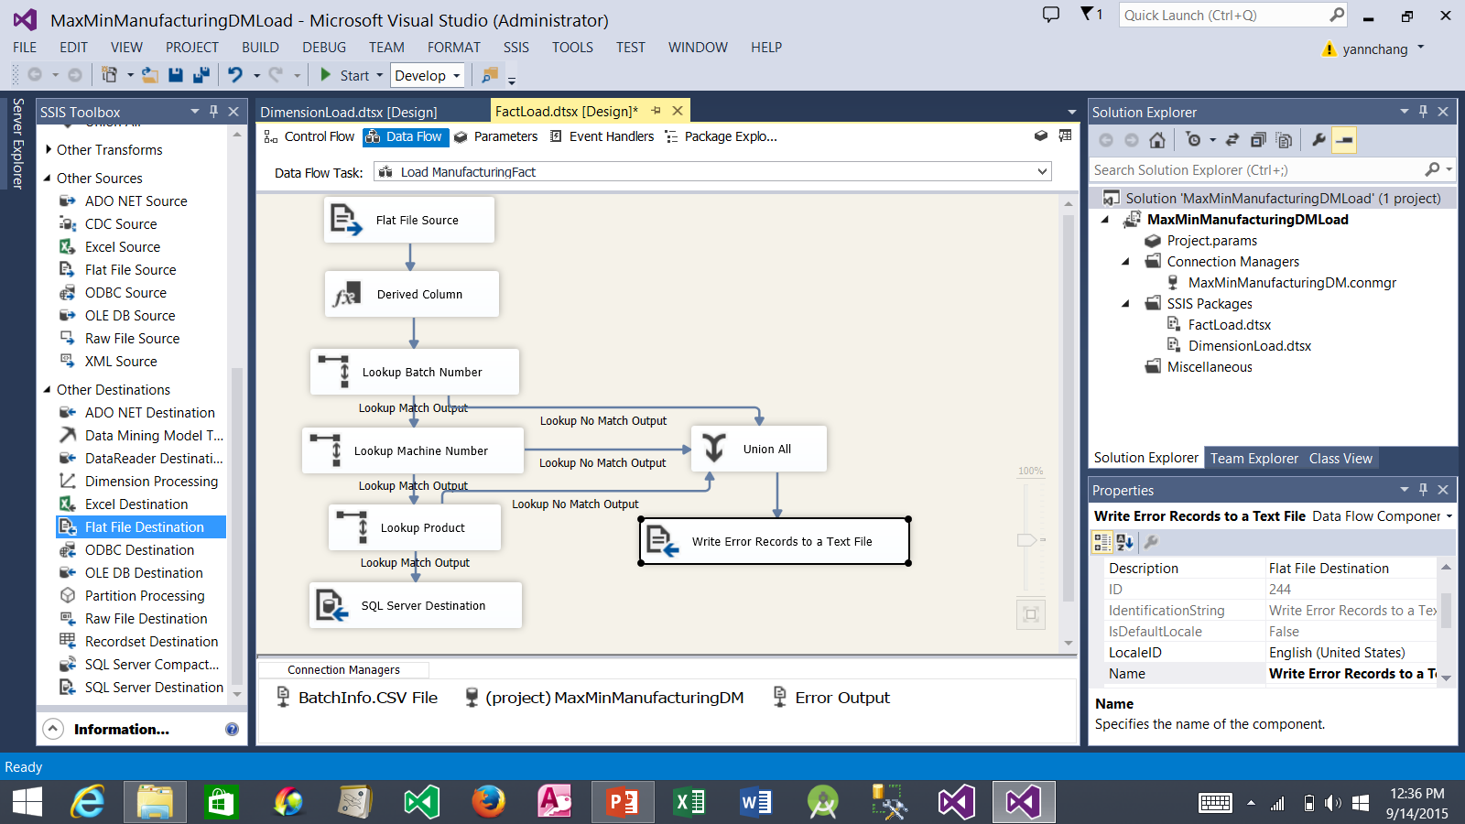
Creating the Load ManufacturingFact Data Flow (continued)
1. At this point, the Data Flow tab should appear as shown here.

Slide 53
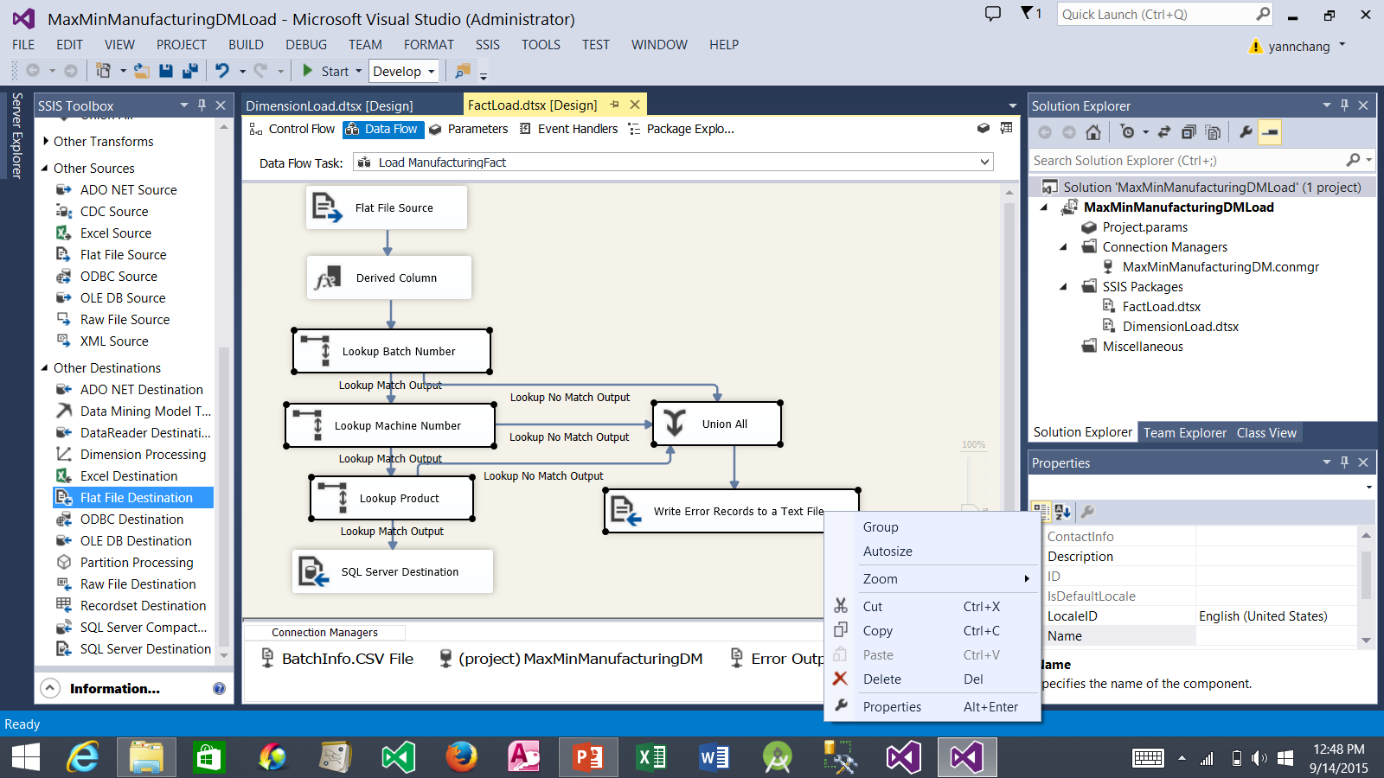
Creating the Load ManufacturingFact Data Flow (continued)
1. Hold down CTRL key and click the following items: Lookup Batch Number, Lookup Machine Number, Lookup Product, Union All, Write Error Records to a Text File.
2. While the above five mentioned items are selected, right-click the Write Error Records to a Text File and then select Group.

Slide 54
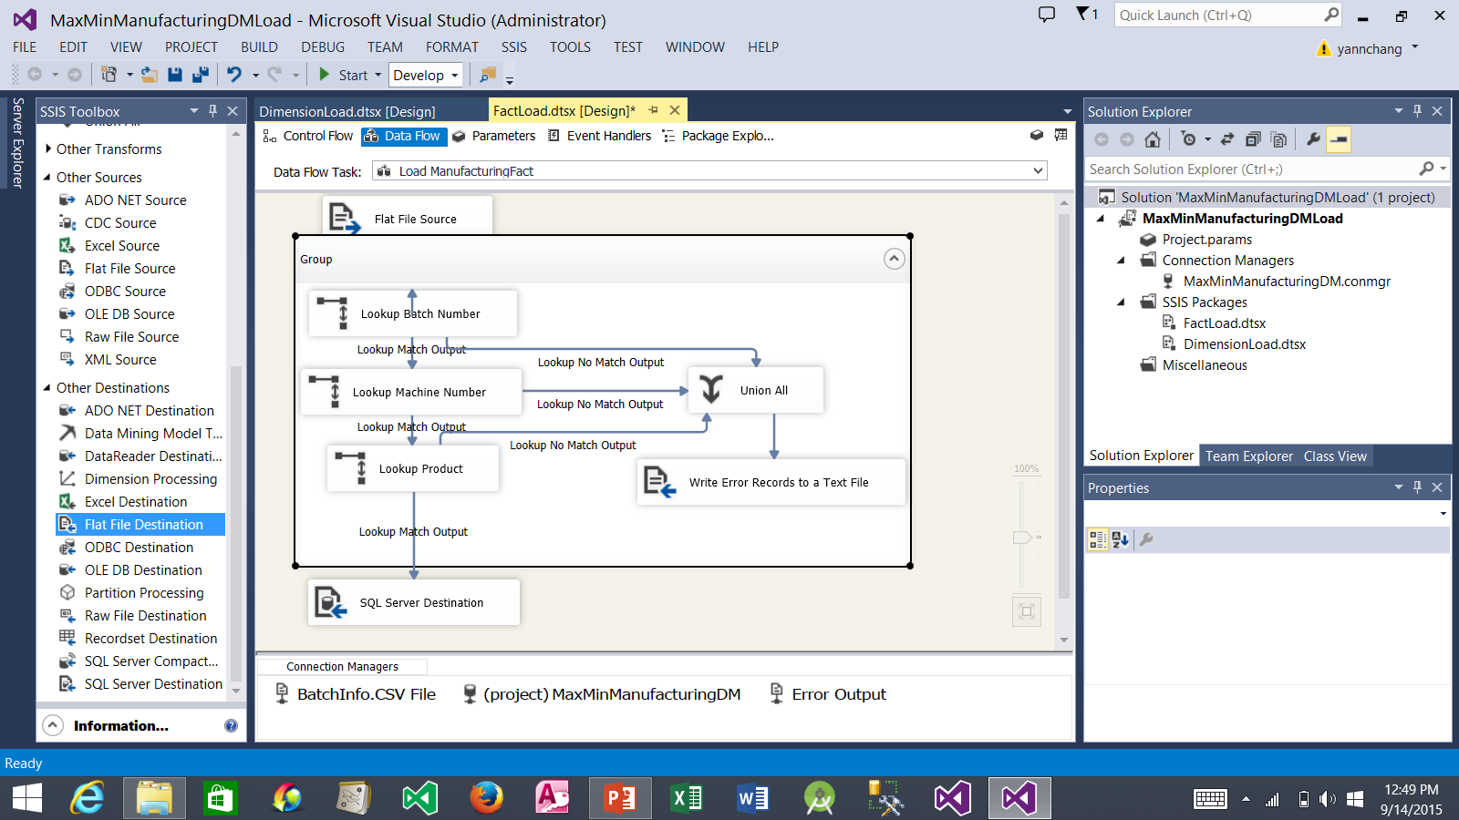
Creating the Load ManufacturingFact Data Flow (continued)
1. At this point, the five items are grouped. Click the ^ button to contract the group.

Slide 55
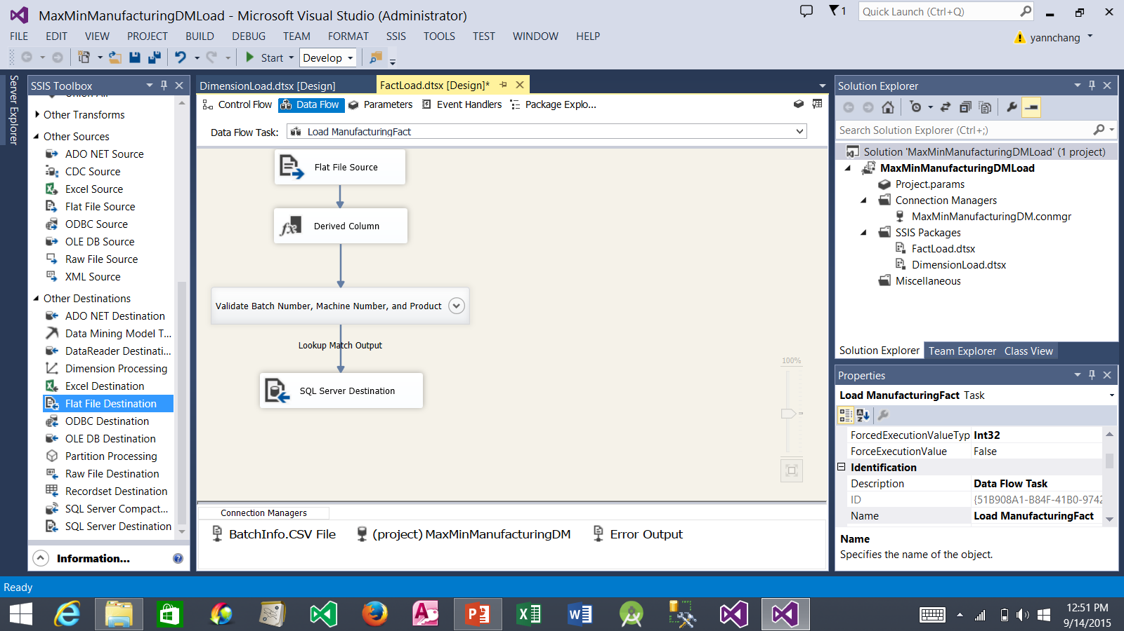
Creating the Load ManufacturingFact Data Flow (continued)
1. Position the contracted group between Derived Column and SQL Server Destination items as shown here. Rename the Group item to Validate Batch Number, Machine Number, and Product.

Slide 56

Creating the Load InventoryFact Data Flow
1. Drag another Data Flow Task and drop it here. Rename it to Load InventoryFact. We do not need to set precedence between this task and the other tasks - it does not matter when the InventoryFact table is populated relative to the operations being done on the other tables.
2. Double click it. This takes you to the Data Flow tab.

Slide 57

Creating the Load InventoryFact Data Flow (continued)
2. The Configure OLE DB Connection Manager dialog box appears.
3. Click the New button to create a new data connection.
1. Right-click in the Connection Managers tray; and select New OLE DB Connection from the context menu.

Slide 58

Creating the Load InventoryFact Data Flow (continued)
1. Enter the server name here: yourComputerName/databaseInstanceName
2. Select OrderProcessingSystem from the drop-down list. Note: (a) if the drop-down list is empty, either your server name or your login credentials are incorrect. (b) if the drop-down list is not empty but you do not see the OrderProcessingSystem in the list, you did not properly restore the OrderProcessingSystem database from the backup file (see Slide #2).

Slide 59

Creating the Load InventoryFact Data Flow (continued)
1. A new OLE DB Data Connection is created.
2. Click the OK button.

Slide 60

Creating the Load InventoryFact Data Flow (continued)
2. Drag an OLE DB Source and drop it here. Then, double click it. The OLE DB Source Editor dialog box appears.
1. Rename the data connection to OrderProcessingSystem.

Slide 61

Creating the Load InventoryFact Data Flow (continued)
1. Be sure that OrderProcessingSystem is selected.
2. Select dbo.Inventory from the drop-down list.
3. Click the OK button.

Slide 62

Creating the Load InventoryFact Data Flow (continued)
2. Select the OLE DB Source item. Drag the blue data flow arrow and drop it on top of the Lookup Product. This connects the source item to the transformation item.
3. Double click it. The Lookup Transformation Editor dialog box appears.
1. Drag a Lookup item and drop it here. Rename it to Lookup Product.

Slide 63

Creating the Load InventoryFact Data Flow (continued)
1. Select Redirect rows to no match output from the drop-down list.
2. Select Connection to view the Connection page.

Slide 64

Creating the Load InventoryFact Data Flow (continued)
1. Select MaxMinManufacturingDM from the drop-down list.
3. Select Columns to view the Columns page.
2. Select dbo.DimProduct from the drop-down list.

Slide 65

Creating the Load InventoryFact Data Flow (continued)
1. Drag Code from the Available Input Columns list and drop it on ProductCode in the Available Lookup Columns list.
2. Click the OK button.

Slide 66

Creating the Load InventoryFact Data Flow (continued)
2. Select Lookup Product. Drag the blue data flow arrow and drop it on top of the Data Conversion item. The Input Output Selection dialog box appears.
3. Select Lookup Match Output from the drop-down list.
1. Drag a Data Conversion item and drop it here.
4. Click the OK button.
5. Double click the Data Conversion item.

Slide 67

Creating the Load InventoryFact Data Flow (continued)
1. Check Material column.
2. Enter Material-Unicode.
3. Select Unicode string [DT_WSTR] from the drop-down list.
4. Click the OK button.

Slide 68

Creating the Load InventoryFact Data Flow (continued)
2. Select it. Drag the blue data flow arrow and drop it on top of the SQL Server Destination item.
1. Drag a SQL Server Destination and drop it here.
3. Double click it.

Slide 69

Creating the Load InventoryFact Data Flow (continued)
1. Select MaxMinManufacturingDM from the drop-down list.
2. Select dbo.InventoryFact from the drop-down list.
3. Select Mappings to view the Mappings page.

Slide 70

Creating the Load InventoryFact Data Flow (continued)
1. Delete the line that joins the Material column in both list.
2. Use drag-and-drop to add mappings as shown here.
3. Click the OK button.

Slide 71

Creating the Load InventoryFact Data Flow (continued)
2. Select the Lookup Product item. Drag the unattached blue data flow arrow and drop it on top of the Write Inventory Error Records item.
3. Double click it.
1. Drag a Flat File Destination item and drop it here. Rename it as shown.

Slide 72

Creating the Load InventoryFact Data Flow (continued)
1. Click the New button. The Flat File Format window appears.
2. Be sure Delimited is selected.
3. Click the OK button.

Slide 73

Creating the Load InventoryFact Data Flow (continued)
1. Click the Browse button. The Open window appears.
3. Click the Open button.
2. Browse to the same folder you selected for the manufacturing error text file. Enter InvInfoErrors.txt

Slide 74

Creating the Load InventoryFact Data Flow (continued)
1. Be sure to check this option.
2. Click the OK button.

Slide 75

Creating the Load InventoryFact Data Flow (continued)
1. The input columns should be automatically mapped to the destination columns.
2. Click the OK button.

Slide 76

Creating the Load InventoryFact Data Flow (continued)
4. Click the Start button to execute the completed FactLoad.dtsx package.
2. Click the Save All button to save the completed package.
3. Click on the empty space here to make sure that FactLoad.dtsx is the active window before we execute it.
1. The Data Flow tab should appears as shown here.

Slide 77

Creating the Load InventoryFact Data Flow (continued)
1. The FactLoad.dtsx package is completed successfully. Click the blue link to switch to design mode. You are done with Tutorial 3 and you can exit the SQL Server Data Tools. In the next tutorial, we will create a Multidimensional Business Intelligence Semantic Model (a cube) based on the MaxMinManufacturingDM data mart.
2. Note that at this point, the InventoryFact table in the MaxMinManufacturingDM data mart has been populated. You can check it using the SQL Server Management Studio as shown on the next slide. Similarly, the ManufacturingFact table should have been populated as well.

Slide 78

The Content of the InventoryFact Table

